Slide 1


Slide 2
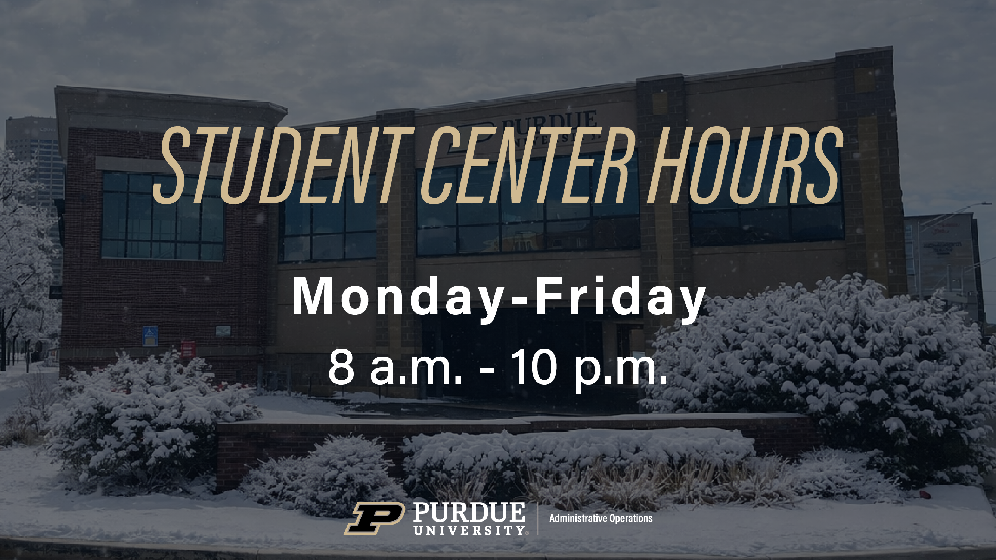

Slide 3


Take advantage of Winter and Summer sessions to create a pathway to a minor or a certificate!
All courses are available in Indianapolis or online. Consult with your advisor to determine the best fit for your goals and schedule! There are many to choose from, here are just a few…
College of Health & Human Sciences - Psychology
Daniels School of Business
Management
College of Liberal Arts
Law and Society
College of Liberal Arts
Cornerstone Certificate
Certificate in Entrepreneurship and Innovation
College of Engineering
Innovation and Transformational Change
Scan to see all Purdue minors
Scan to learn more or email wintersession@purdue.edu

Slide 4

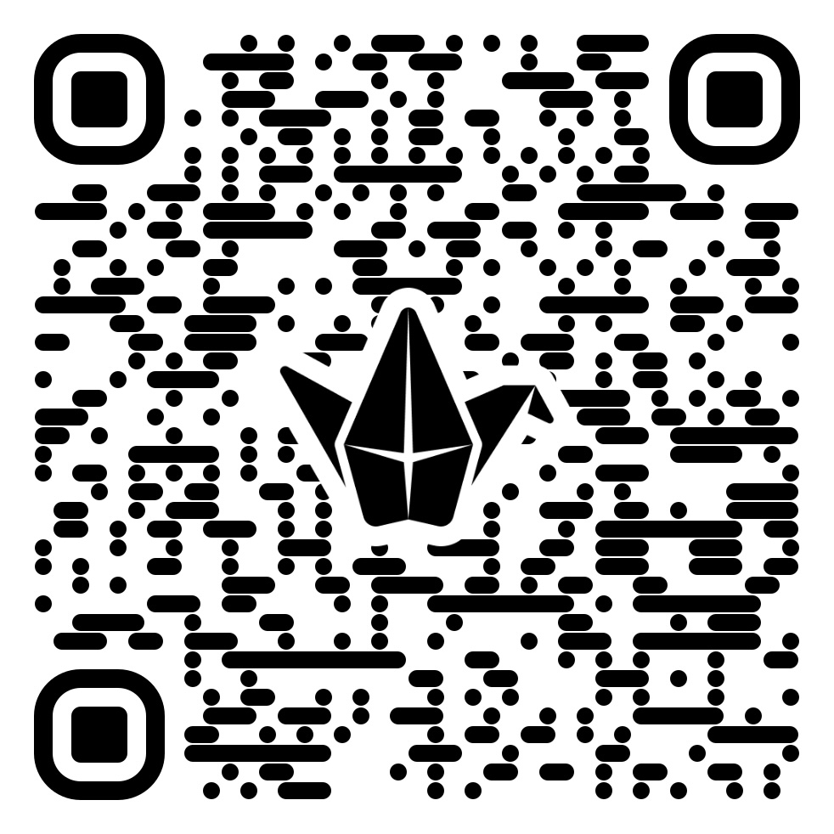
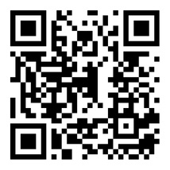
PSG ELECTIONS 2026
A space to connect with students and form or join a three-person ticket.
Fill out the PSG 2026 Updates Form for important election updates
Run in the 2026 Purdue Student Government Elections to lead change, amplify student voices, and shape the Purdue experience.
Executive leadership runs as a three-person ticket:
Student Body President
Vice President – West Lafayette
Vice President – Indianapolis
You can also make an impact through Student Senate.
Each college or campus elects three Senators who advocate for students and influence policy and funding decisions.
CALLOUTS
Callout #1
February 6
ET 103
Callout #2
February 10
ET 103
Callout #3
February 11
Online

Slide 5


Slide 6
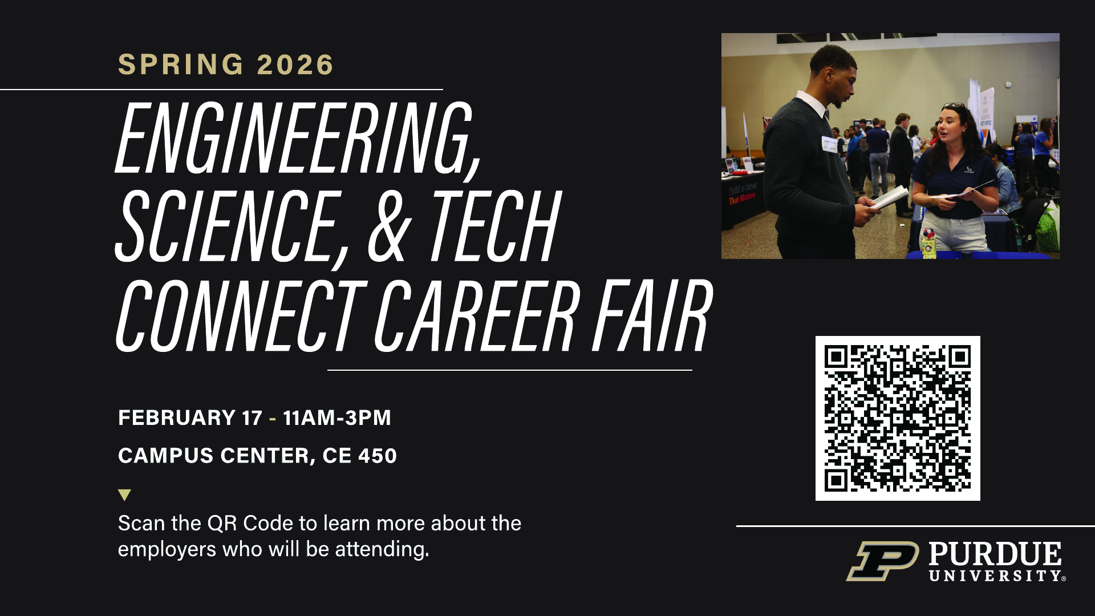

Slide 7
* Attend *
Minors and More - Indianapolis 2026
Coming: February 10, 2026
10 a.m. – 2 p.m.
ET Atrium
Interested in information about Minors in Indianapolis?

Slide 8
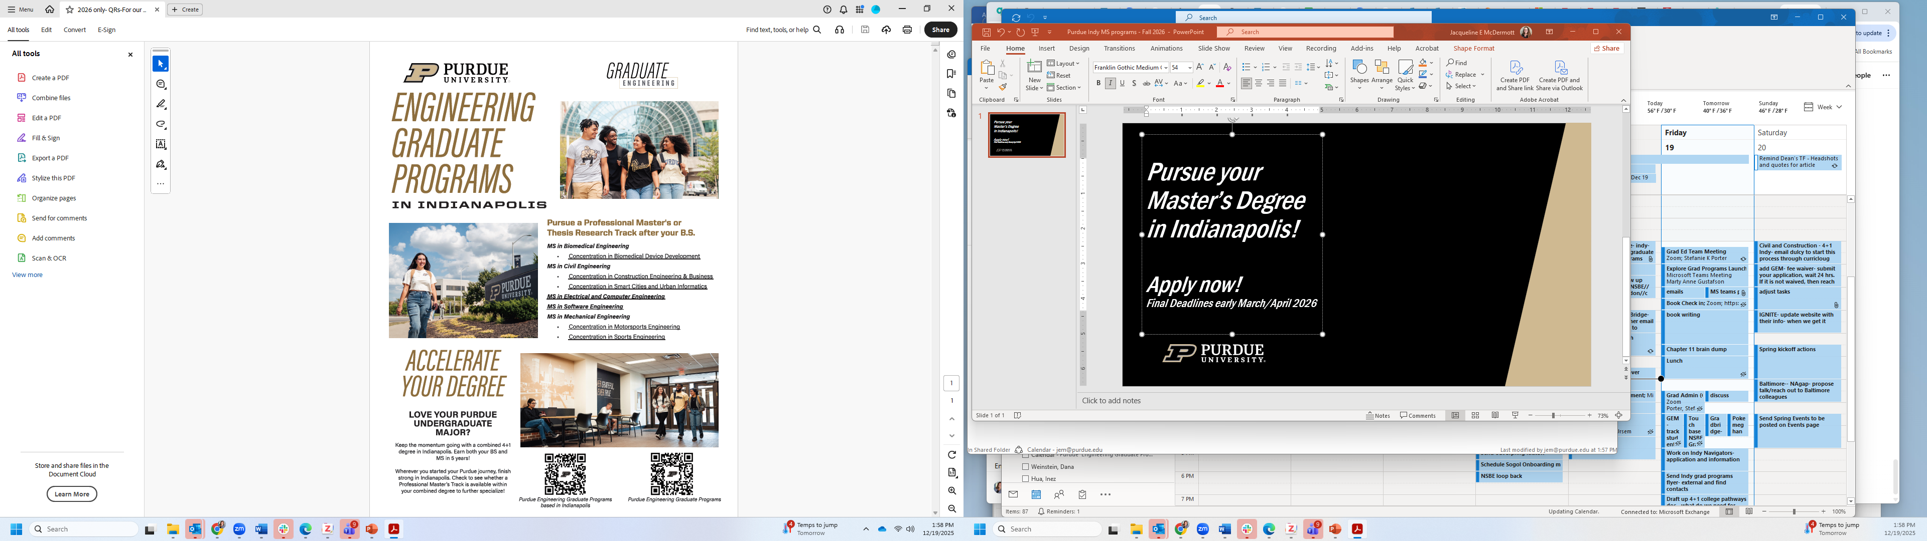
Pursue your Master’s Degree in Indianapolis!
Apply now!
Final Deadlines early March/April 2026
Notes:
8

Slide 9
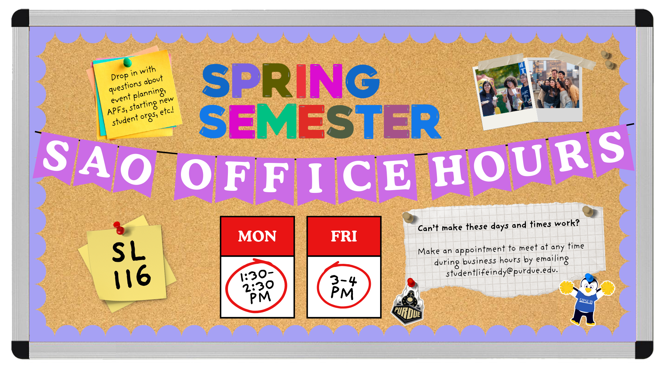


Slide 10
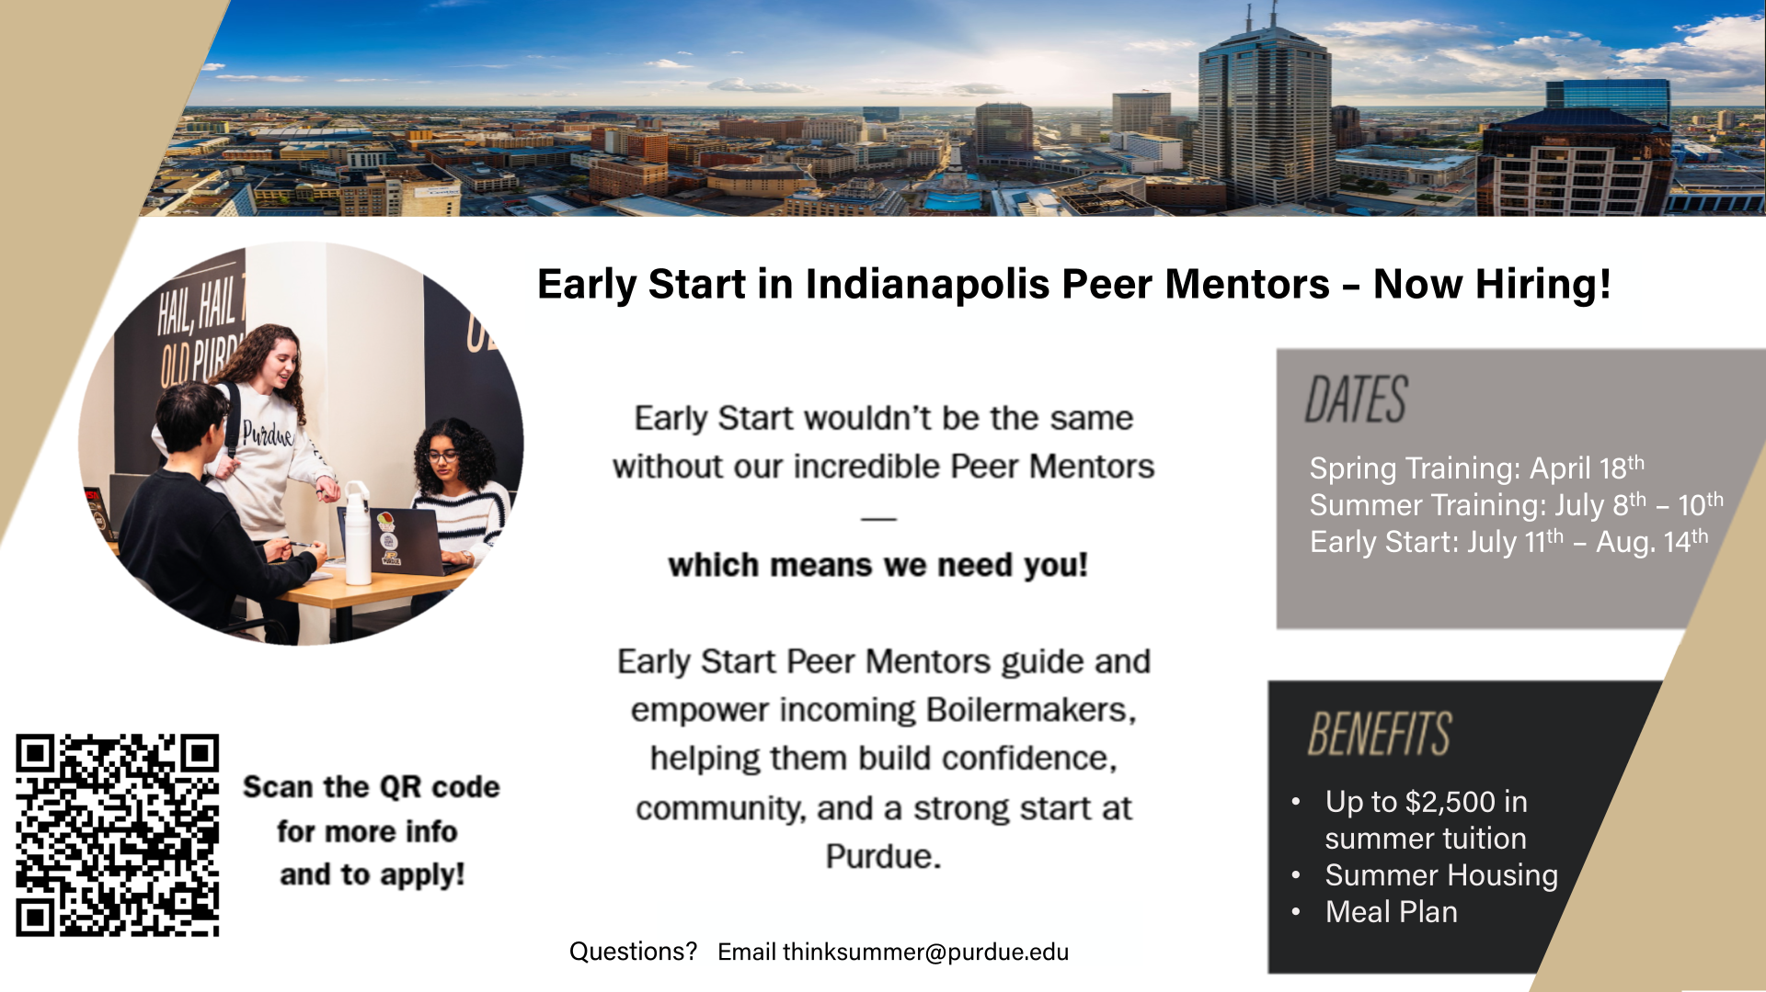
Title, Franklin Gothic Italic 54
Subtitle, Franklin Gothic Bold 24
2/6/26

Slide 11
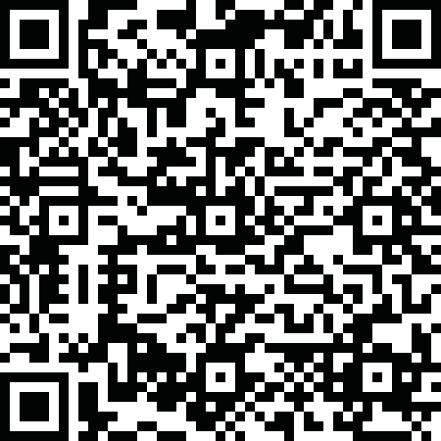

Slide 12








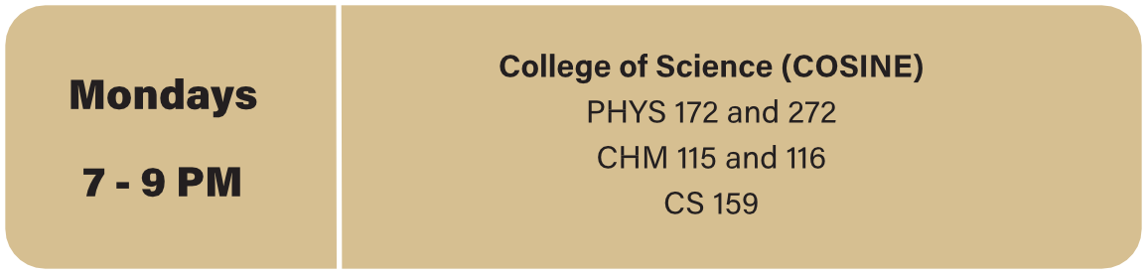
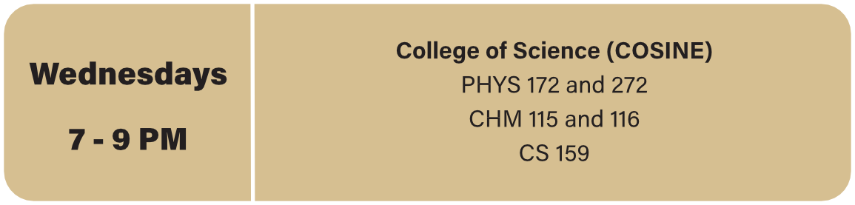
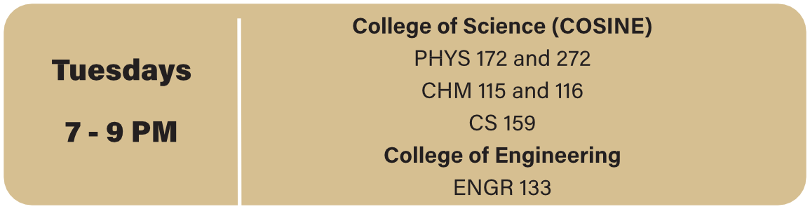
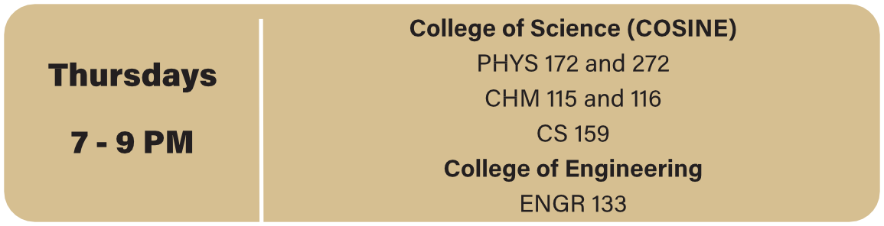


Slide 13
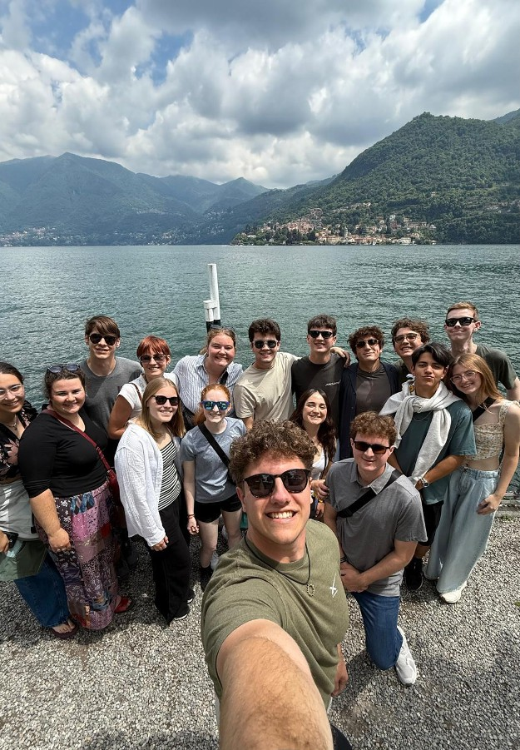






Slide 14
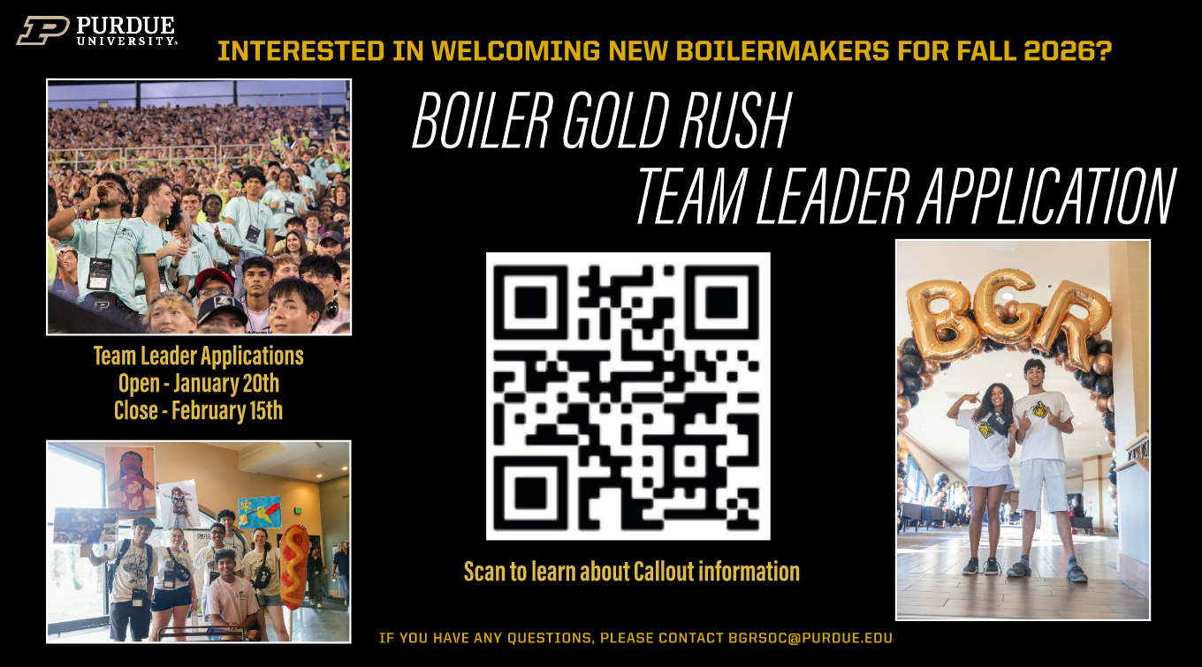

Slide 15


Slide 16
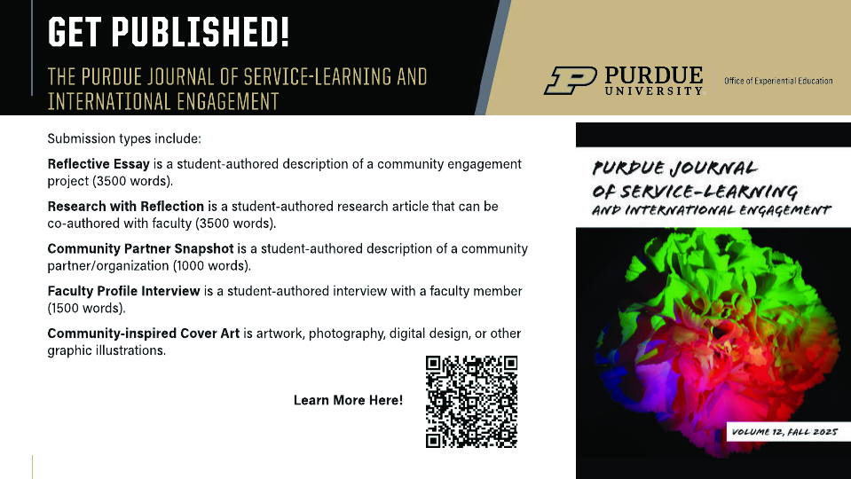

Slide 17

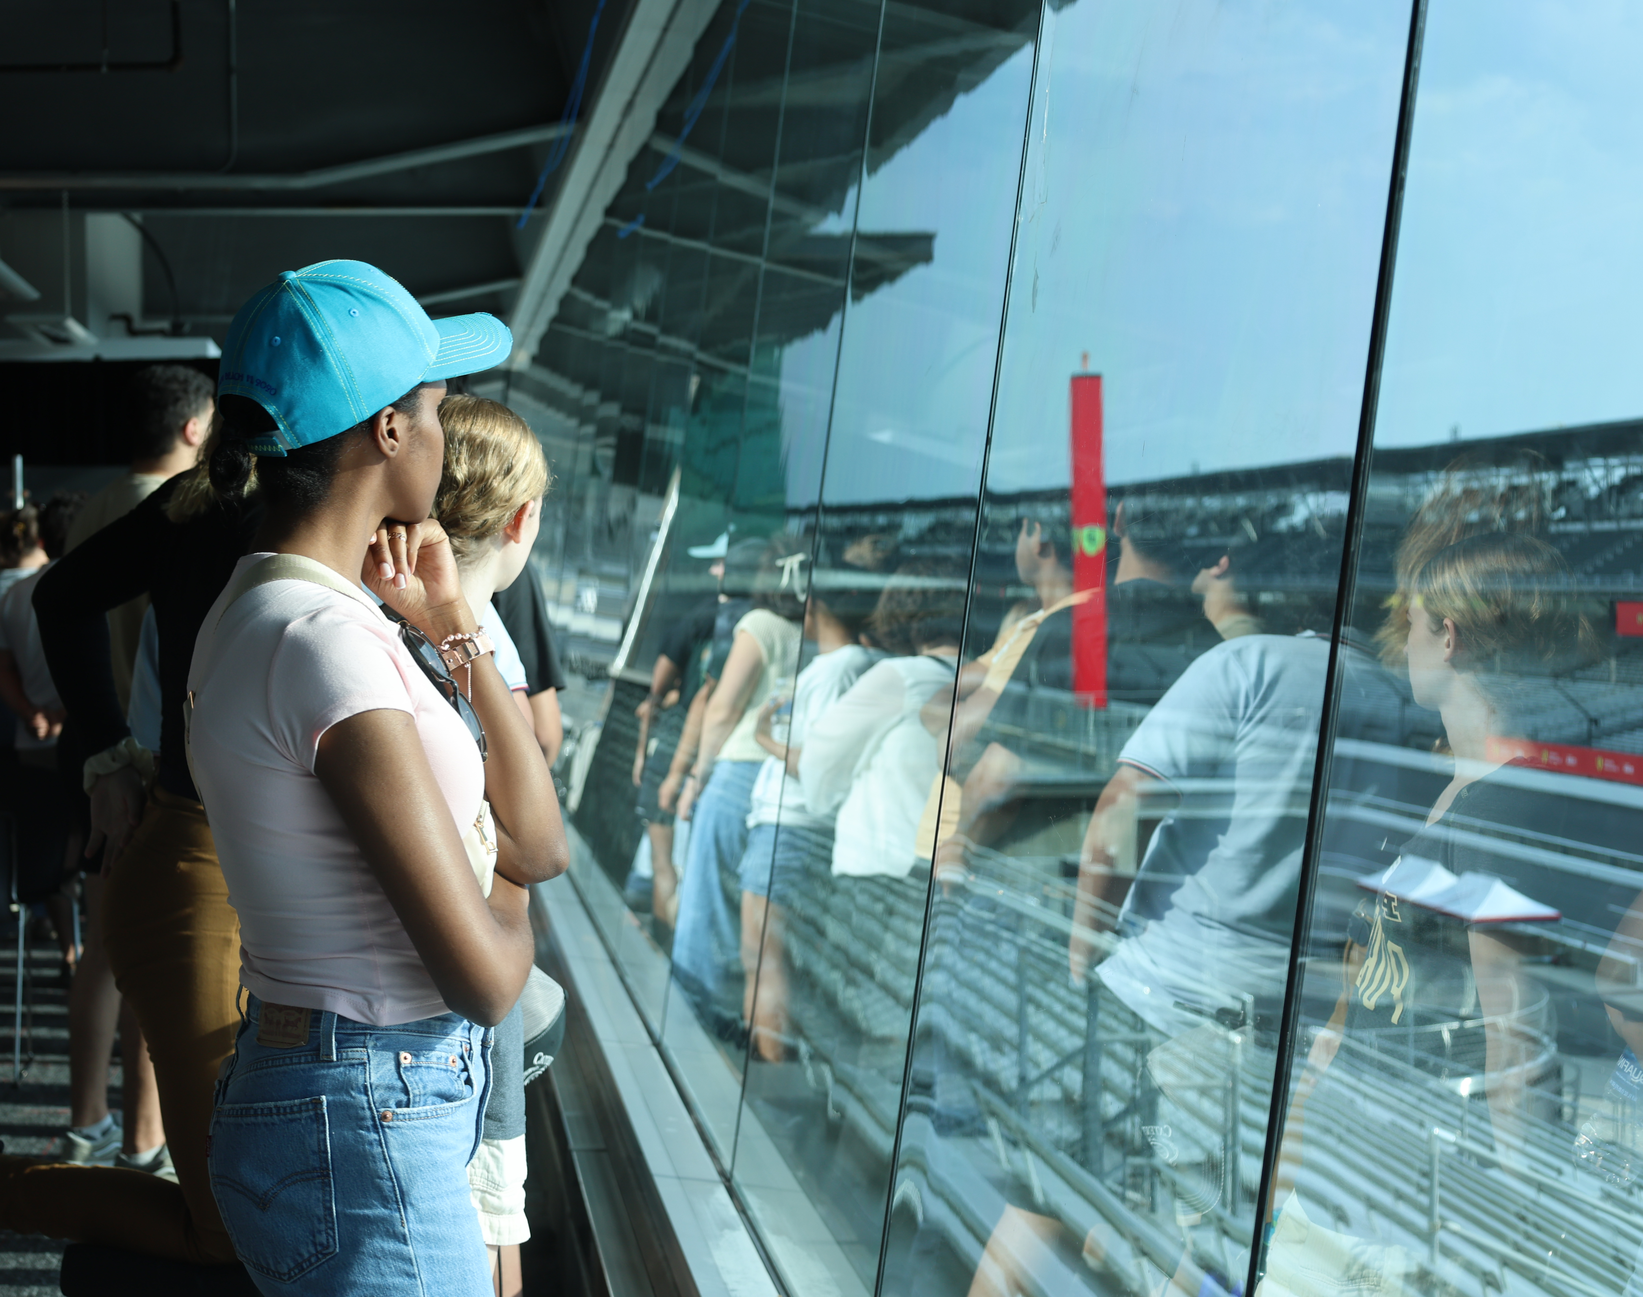
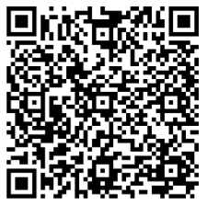
INDY AMPLIFIED: Summer in the Circle City
TRANSFORM YOUR SUMMER EXPERIENCE IN INDIANAPOLIS
Build Professional Skills
Create a Network
Explore the City
The single most TRANSFORMATIVE SKILL I gained is PURPOSE-DRIVEN NETWORKING. Indy Amplified taught me to move beyond polite introductions toward building sustained, mutually beneficial relationships."
Raja Ali
Summer 2025 Program Graduate
Learn more & Apply before April 15

Slide 18


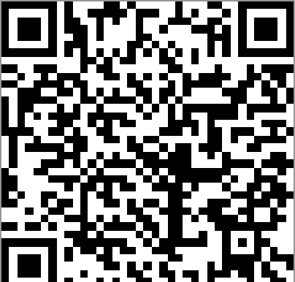
INVITES YOU TO ATTEND
ONE WORLD,
ONE COMMUNITY
This event is all about connection, through meals from around the world, interactive games, creative activities, and a community that remind us we all belong here together.
RSVP Here
Date: Wednesday, February 11, 2026
Time: 4:00 PM – 6:00 PM
Location: The Launch Pad (ET 002)

Slide 19





Slide 20
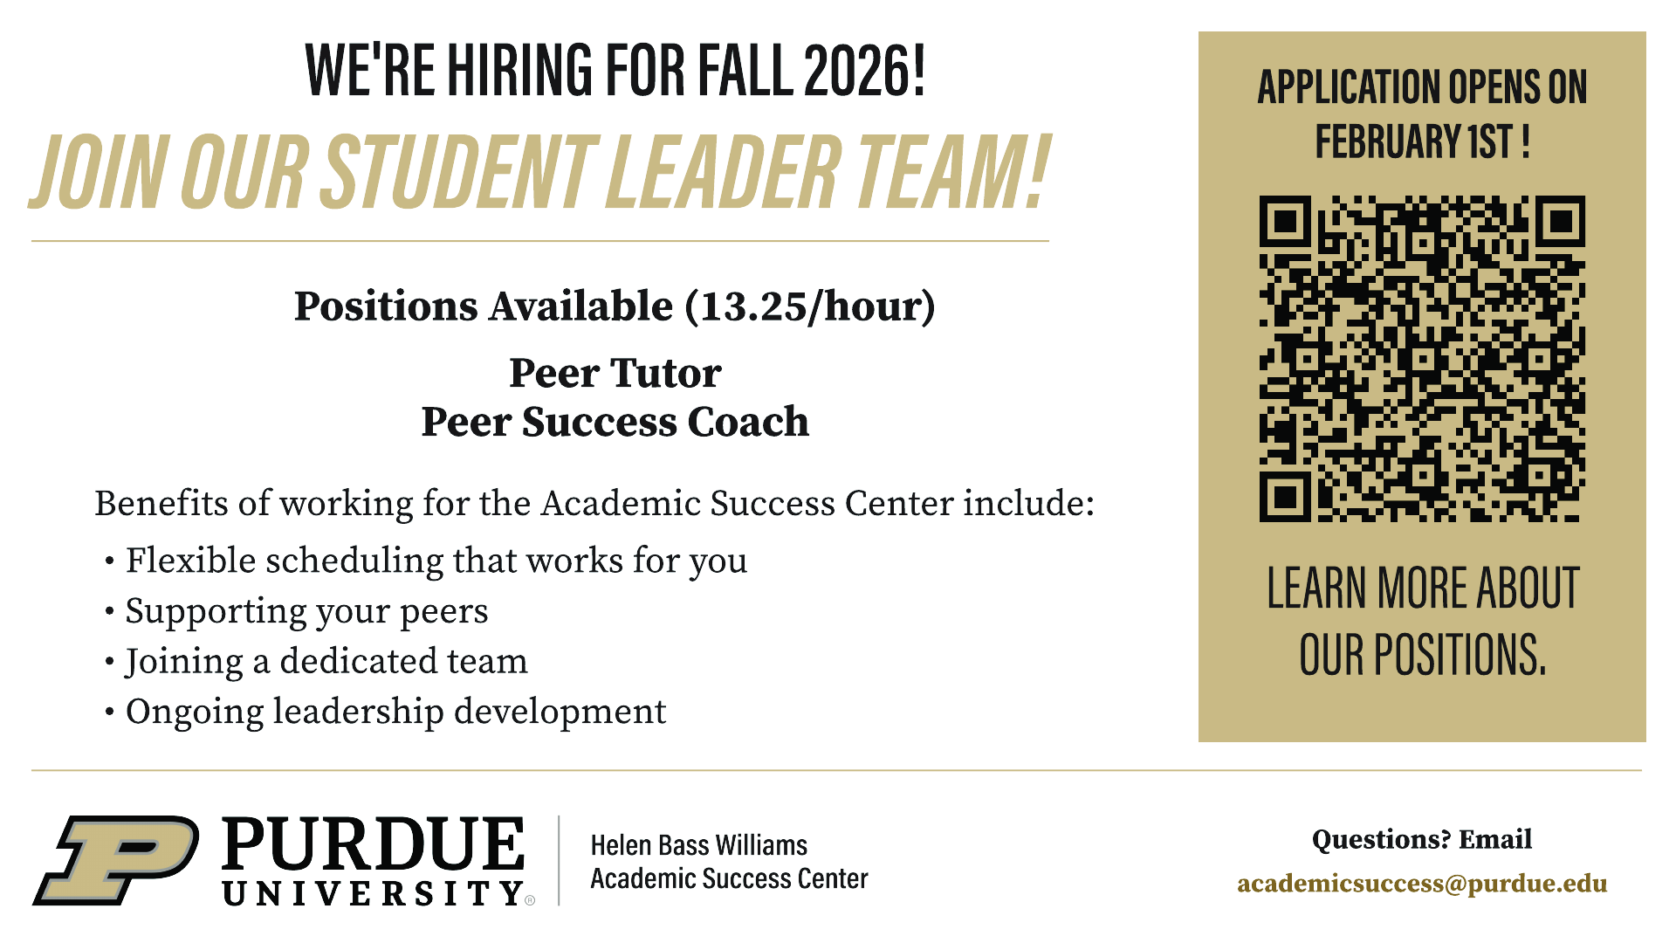

Slide 21
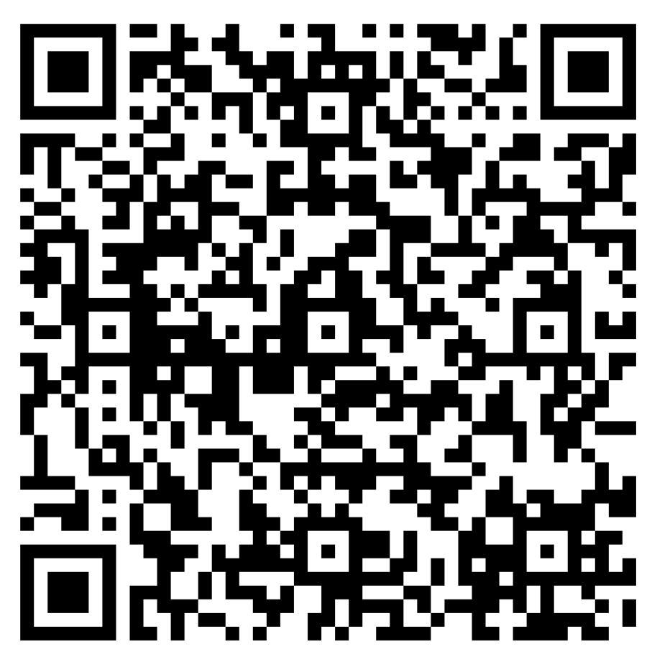

IO 115 Makerspace
SL 113 RSO Workshop
New! Extended Hours
Mon - Fri: 8:30 AM – 10:00 PM
Saturday: 9:00 AM – 5:00 PM
Sunday: Closed
Apply for Saturday Card Access:
Now Open!
Mon – Fri: 8:30 AM – 10:00 PM
Saturday: 9:00 AM – 5:00 PM
Sunday: Closed
Apply for Card Access:

Slide 22


Slide 24
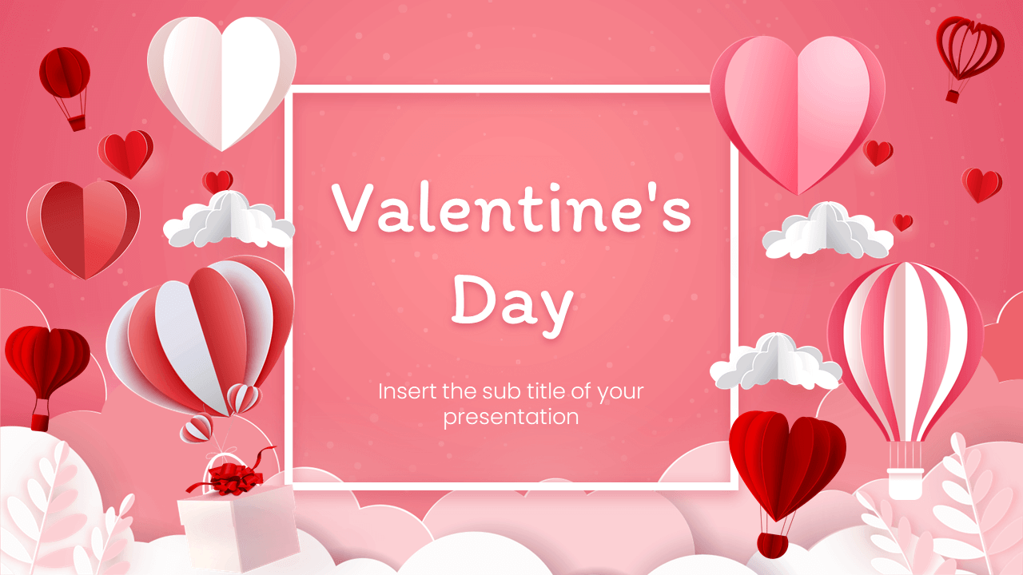







Valentine’s
Arts & Crafts
In celebration of Valentine’s Day, join Cornerstone faculty and Purdue Libraries on Monday, February 9 from 2-4:30pm on the Student Center’s 2nd floor.
We’ll have a variety of activities, crafting supplies, and some treats. Feel free to bring your own projects to share!

Slide 25




Study Abroad
Drop In Advising
SCPI - Rm 128
2.11.26
10AM-2PM
Jessey C. Reed, Advisor

Slide 26
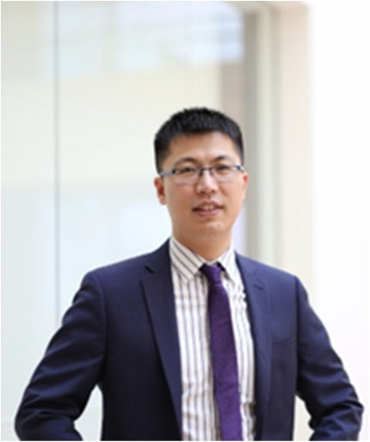
Tao Gao, PhD
Assistant Professor University of Utah
Seminar: Wednesday, Feb 11th—10:30 A.M.—ET 202 - INDY
https://purdue-edu.zoom.us/j/92496707373?pwd=RGghRQDL7yFZOdUXGaHbabnbbtsVoM.1
Understand and Control Charge Transfer Reactions in
Electrochemical Energy and Manufacturing Systems
Abstract:
Electrochemical systems find wide applications in energy and manufacturing applications (e.g., batter-ies, water electrolyzers, metal production, etc.). A physical understanding of thermodynamics and kinet-
ics of the interfacial charge (ion and electron) transfer reaction, especially in emerging electrolyte sys-tems (such as concentrated electrolytes, water-in-salt electrolytes, etc.), is essential for rational electro-
lyte design to enhance performance, reduce cost, and improve scalability.
In the first part of this talk, I will discuss the electro-deposition of transition metals in aqueous environ-
ment, the core reaction in low-cost energy storage (iron and zinc batteries) and emission-free metal production (electrowinning). We demonstrated that concentrated electrolytes can enhance the effi-ciency of these reactions. In addition to the long-held understanding that attributes the improved effi-ciency to better deposit morphology and suppressed water reactivity, our study reveals an overlooked mechanism related to the metal redox (M²⁺/M) and metal-anion complex. I will present our experi-mental findings and discuss the fundamental understanding based on electrode reaction and complex formation equilibria.
In the second part of the talk, I will turn to ion insertion reaction, an important family of charge transfer reactions that underpin batteries, smart windows, and critical material extraction. I will present our un-derstanding of Li insertion kinetics and how we can leverage this understanding to design better elec-trolytes with extreme performance for defense and space applications, and to design a new platform technology for the separation and production of critical metals.
Biography:
Dr. Gao obtained his BS/MS from Tsinghua University, PhD from University of Maryland, College Park, and postdoc training from Massachusetts Institute of Technology. He is currently an assistant professor at the Department of Chemical Engineering, University of Utah. His lab studies electrochemical technologies for energy and manufacturing applications, including batteries, metal production, critical material ex-traction, etc. He has published 70+ papers in journals including Science, Nature Communication, Joule, etc. He has an H-index of 60, with a total citation of more than 23, 000. He is the recipient of NSF CAREER Award (2025), Investigator on the Rise Award at University of Utah (2025), Highly Cited Researcher Recognition by Clarivate (2022-2024), the Emerging investigator Award by Royal Society of Chemistry (RSC) Journal of Material Chemistry (2023), Early Career Investigator Award by the American Chemical Society (ACS) Energy and Fuel Division (2022), Dean’s Dissertation Fellowship at University of Maryland (2016) and Outstanding Graduate Assistant Award at University of Maryland (2016).

Slide 27
INDIANAPOLIS
PURDUE
MECHANICAL
ENGINEERING
AMBASSADORS
The Purdue Mechanical Engineering Ambassadors (PMEA) act as delegates of the Purdue Mechanical Engineering program in promoting unity between students, faculty, alumni, family, and organizations, as well as reaching out to prospective students.
Questions? Email pmea.of.indy@gmail.com

Slide 28

Coffee and Carnations
Let the College of Science bring a little love to your morning!
Thursday, February 12
9:00am – 12:00pm
SL 239 “The Corner”
We’ll have coffee and carnations to brighten your day and remind you that PURDUE LOVES YOU!

