Slide 1


Slide 2


Slide 3
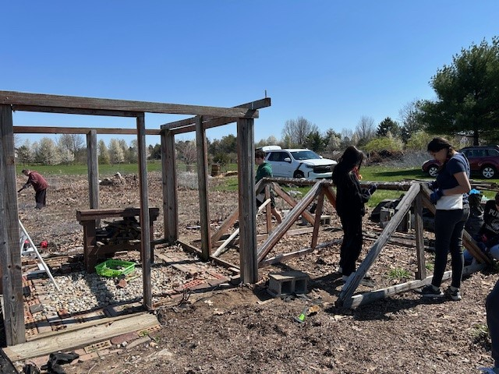
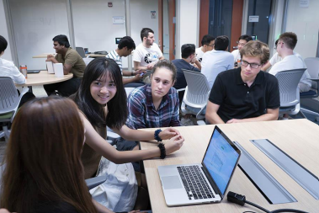
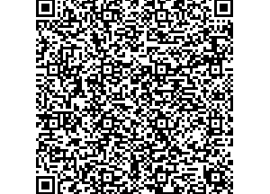
Seeking Student Design Reviewers
EPICS & VIP Design Reviews
Current EPICS & VIP students are encouraged to sign up as a peer reviewer. Learn what other groups are doing and earn PDH credit.
Engineering, Science, Polytechnic and other upperclassmen are encouraged to sign up as external reviewers. Find out about the many EPICS & VIP projects in Indianapolis while sharing your expertise.
Virtual and in-person opportunities available.
Options available Monday through Friday, February 23 - 27

Slide 4


Slide 5



Slide 6


Slide 7









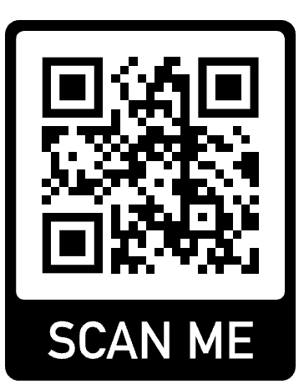
PURDUE INDY’S CS CLUB
ready, set, go !
ENGINES!
HACK
INDY
2026
START
REGISTER @ HACKINDY.IO
YOUR
MARCH 27-29
520 INDIANA AVE, INDIANAPOLIS, IN 46202 - PURDUE STUDENT CENTER

Slide 8


LEAP Retreat
Leadership Experience at Purdue
LEAP is a leadership development opportunity aimed at providing students with the tools necessary to be successful at Purdue and beyond.
Lunch provided.
Saturday, February 21st
11:45a – 3:30p
ET 327
Plus, additional information.

Slide 9


Take advantage of Winter and Summer sessions to create a pathway to a minor or a certificate!
All courses are available in Indianapolis or online. Consult with your advisor to determine the best fit for your goals and schedule! There are many to choose from, here are just a few…
College of Health & Human Sciences - Psychology
Daniels School of Business
Management
College of Liberal Arts
Law and Society
College of Liberal Arts
Cornerstone Certificate
Certificate in Entrepreneurship and Innovation
College of Engineering
Innovation and Transformational Change
Scan to see all Purdue minors
Scan to learn more or email wintersession@purdue.edu

Slide 10

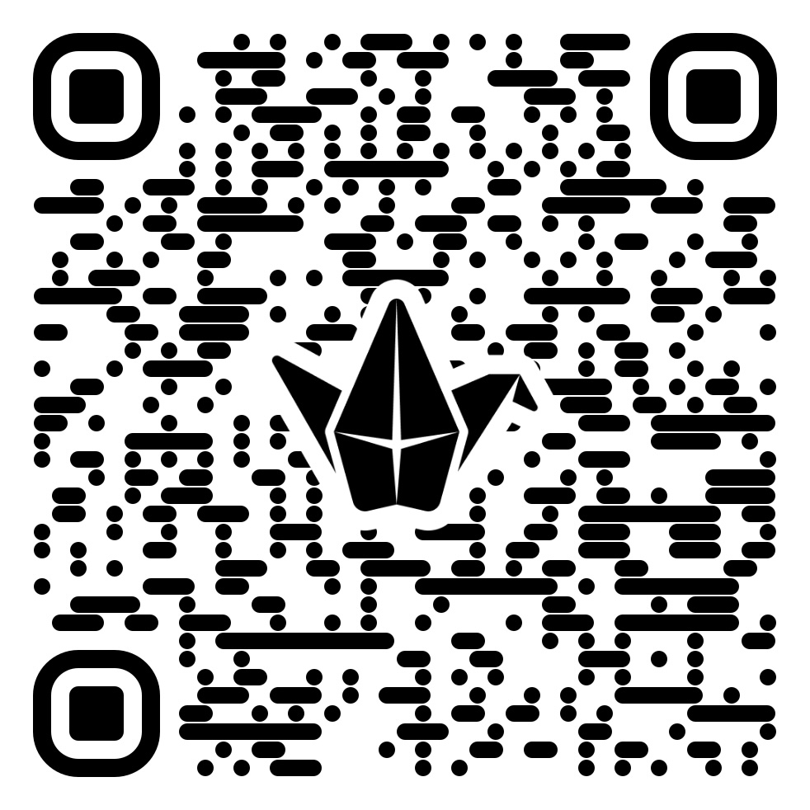
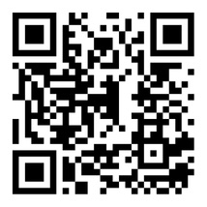
PSG ELECTIONS 2026
A space to connect with students and form or join a three-person ticket.
Fill out the PSG 2026 Updates Form for important election updates
Run in the 2026 Purdue Student Government Elections to lead change, amplify student voices, and shape the Purdue experience.
Executive leadership runs as a three-person ticket:
Student Body President
Vice President – West Lafayette
Vice President – Indianapolis
You can also make an impact through Student Senate.
Each college or campus elects three Senators who advocate for students and influence policy and funding decisions.
CALLOUTS
Callout #1 February 6 ET 103
Callout #2 February 10 ET 103
Callout #3
February 11 Online

Slide 11
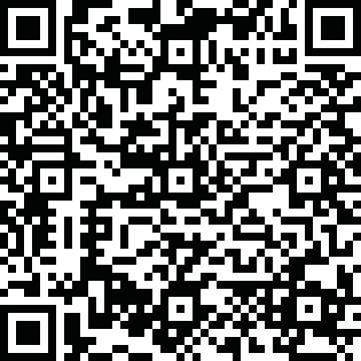

Slide 12


Slide 13


Slide 14


IO 115 Makerspace
SL 113 RSO Workshop
New! Extended Hours
Mon - Fri: 8:30 AM – 10:00 PM
Saturday: 9:00 AM – 5:00 PM
Sunday: Closed
Apply for Saturday Card Access:
Now Open!
Mon – Fri: 8:30 AM – 10:00 PM
Saturday: 9:00 AM – 5:00 PM
Sunday: Closed
Apply for Card Access:

Slide 16
INDIANAPOLIS
PURDUE
MECHANICAL
ENGINEERING
AMBASSADORS
The Purdue Mechanical Engineering Ambassadors (PMEA) act as delegates of the Purdue Mechanical Engineering program in promoting unity between students, faculty, alumni, family, and organizations, as well as reaching out to prospective students.
Questions? Email pmea.of.indy@gmail.com

