Slide 1
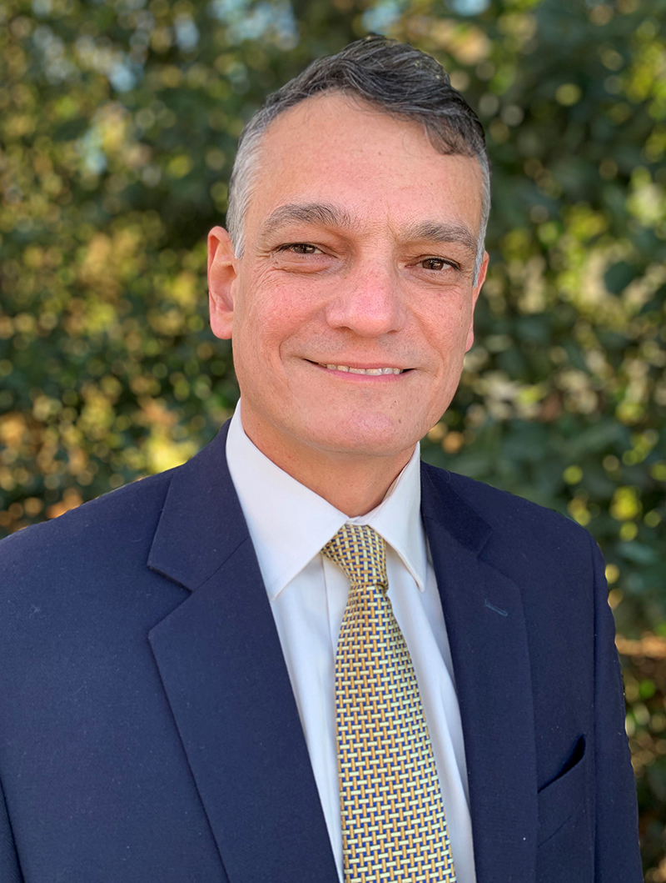
Meet Your Dean
Purdue Polytechnic students can meet with
Dean Castro and his leadership team
Wednesday, March 25, 2026
1:00pm – 1:30pm
Lilly Auditorium (Library Basement)

Slide 2

Book a 1-on-1 Strengths Coaching Session
Talk with a Strengths Champion about utilizing your Top 5 Strengths. 3:00 pm to 6:00 pm, Student Center First Floor Interviewing from a Strengths-Based Perspective Learn how to communicate your Strengths during the interview process. Sessions begin at: 3:30 pm and 4:30 pm, Student Center 102

Slide 3


Slide 4


Slide 5


Slide 6


Slide 7

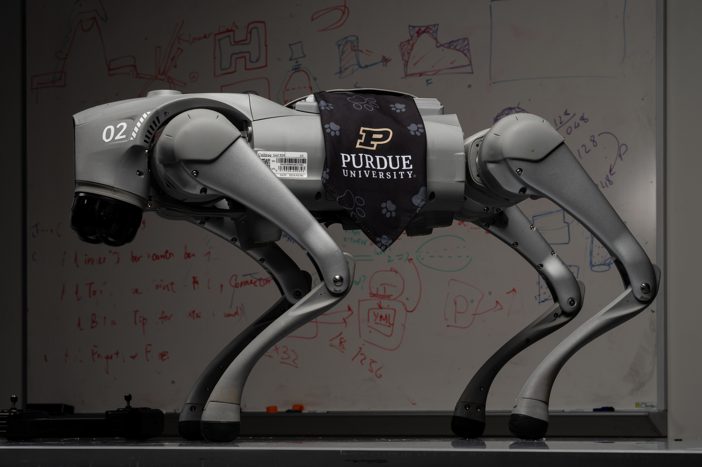
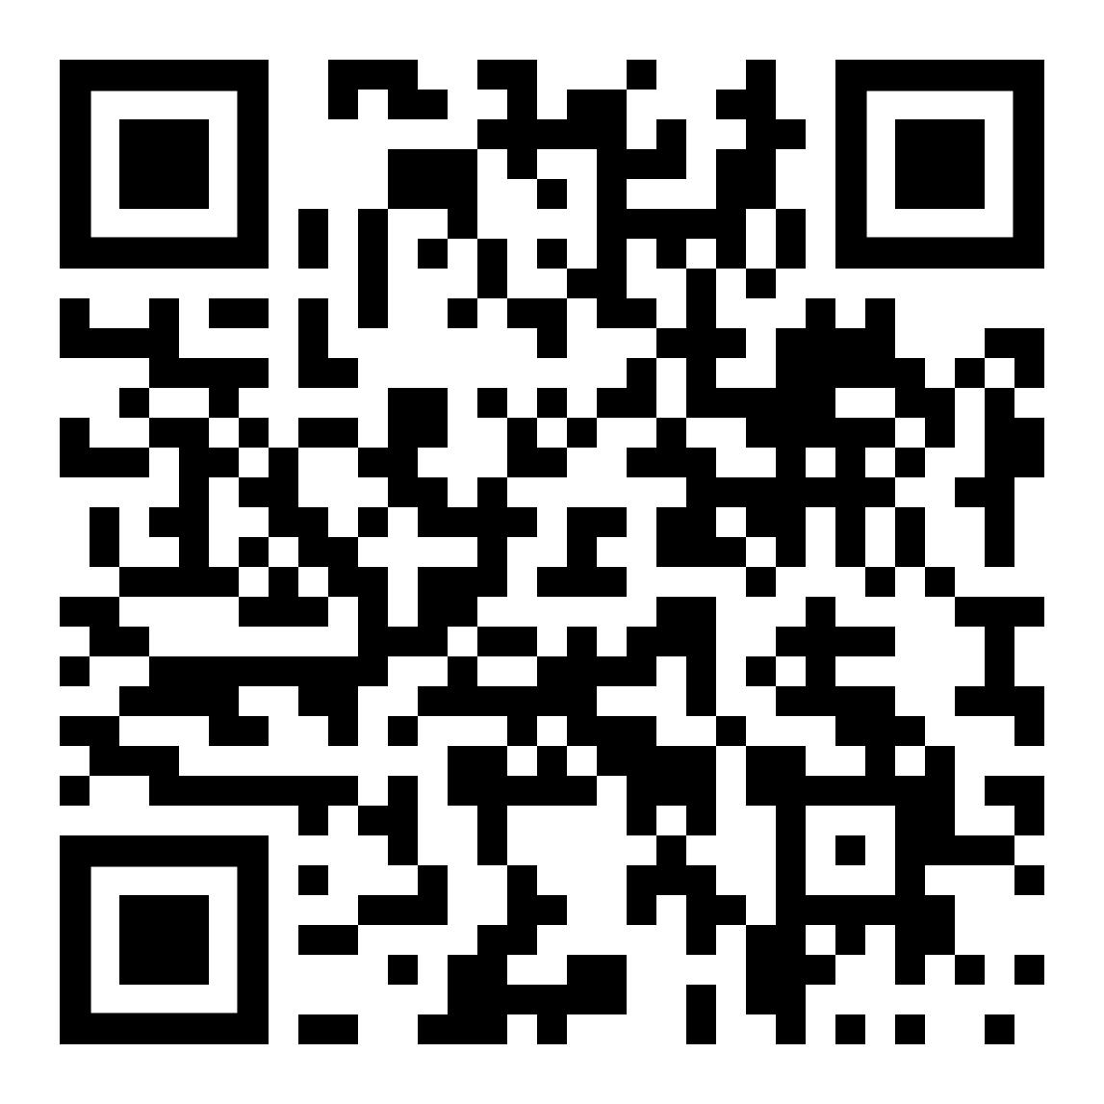
Purdue University is proud to host the inaugural Robotics Day— a dynamic showcase of innovation, collaboration, and discovery. This event will bring together industry leaders, faculty and students to explore the future of robotics, from fundamental research to real-world applications shaping our world.
Thursday, March 26, 2026
Location: Purdue Memorial Union (WL)
Time: 9:00am – 7:00pm (various sessions)
See full schedule on registration website

Slide 8




Collaborative Leadership Certificate Open to all majors – new courses in Indianapolis!
EDPS 31500 Interpersonal Skills
EDPS 31600 Cross-Cultural Settings
EDPS 31700 Mentoring
Experiential, case‑based course exploring motivation and systems theory, with practical skill‑building in conducting difficult workplace conversations.
Examines cultural dimensions of leadership in the U.S. and globally.
Overview of mentoring as a core skill in collaborative leadership, featuring a semester‑long service‑learning experience pairing students with undergraduate mentees through weekly mentoring sessions. Builds knowledge, skills, and dispositions for effective peer mentorship.
Meets Oral Communication (OC) foundational requirement.
Meets Human Cultures: Behavioral Social Sciences (BBS) requirement.
Contact your academic advisor for more information!

Slide 9



Slide 10
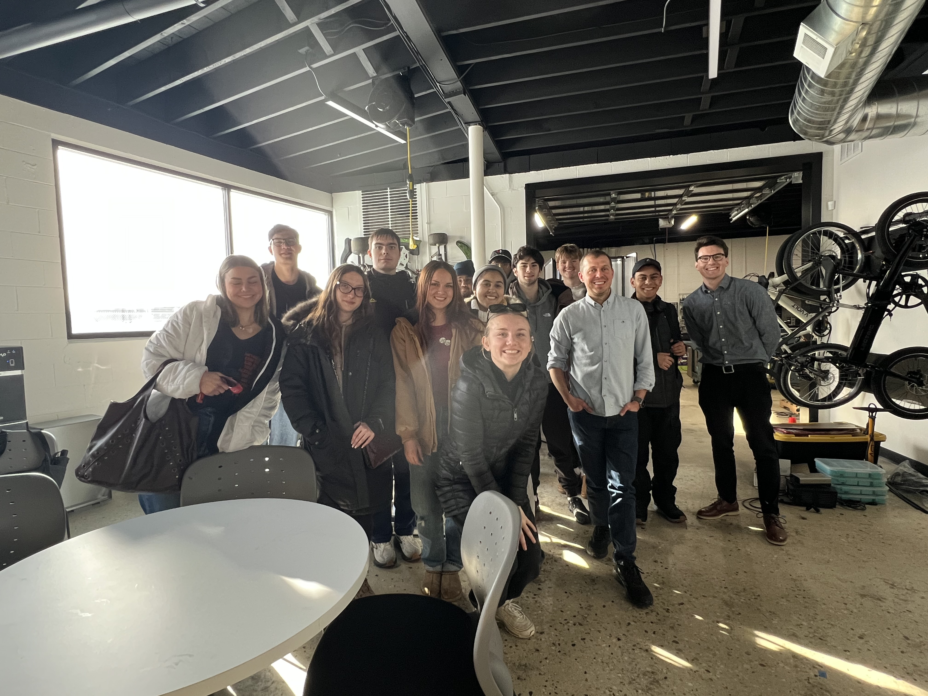
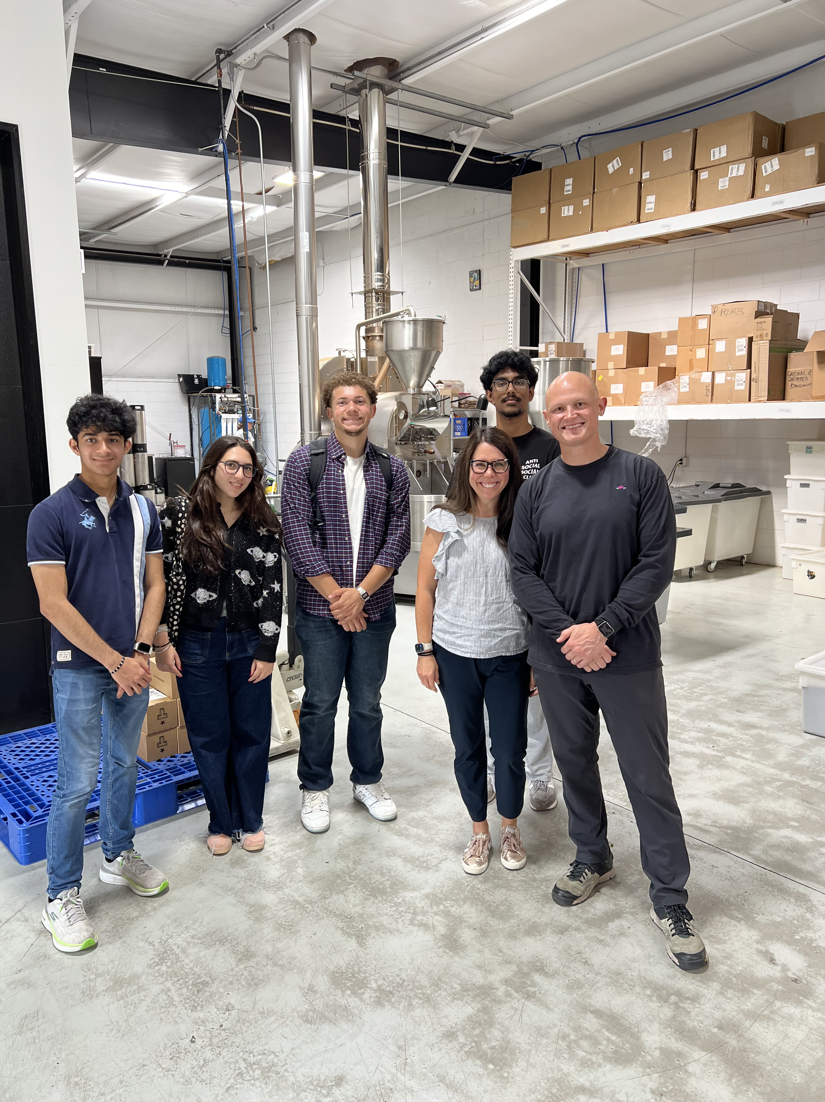

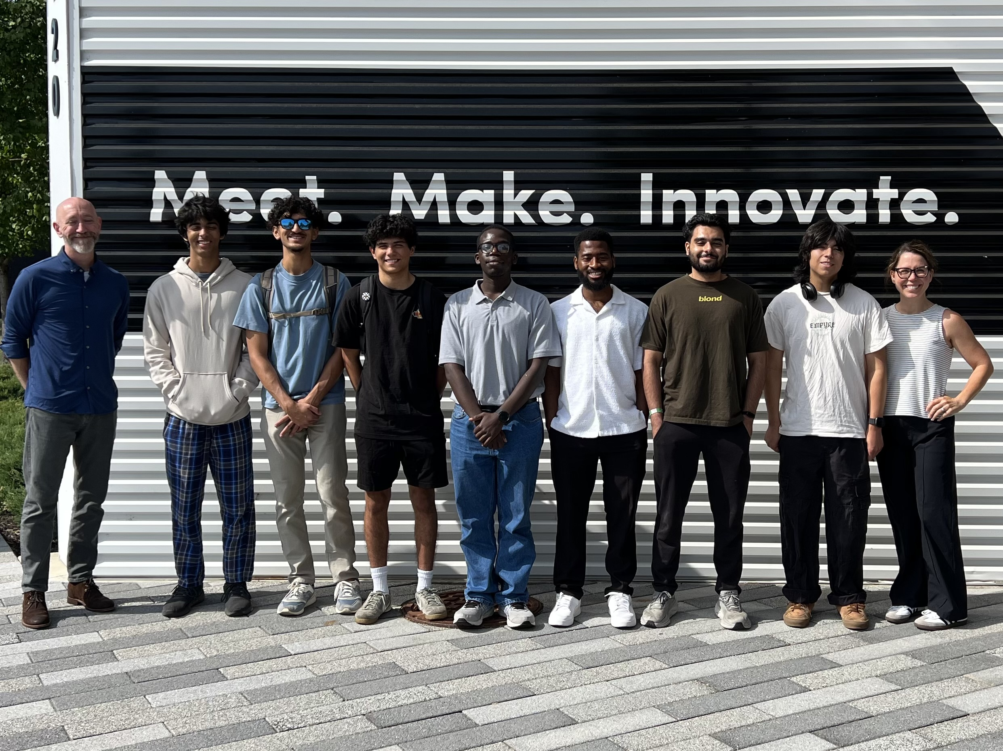

Start your Purdue Certificate in Entrepreneurship Fall 2026
Register for ENTR 20000
Tuesday/Thursday: 9:00 to 10:45
OR
Tuesday/Thursday: 1:30 to 2:45

Slide 11
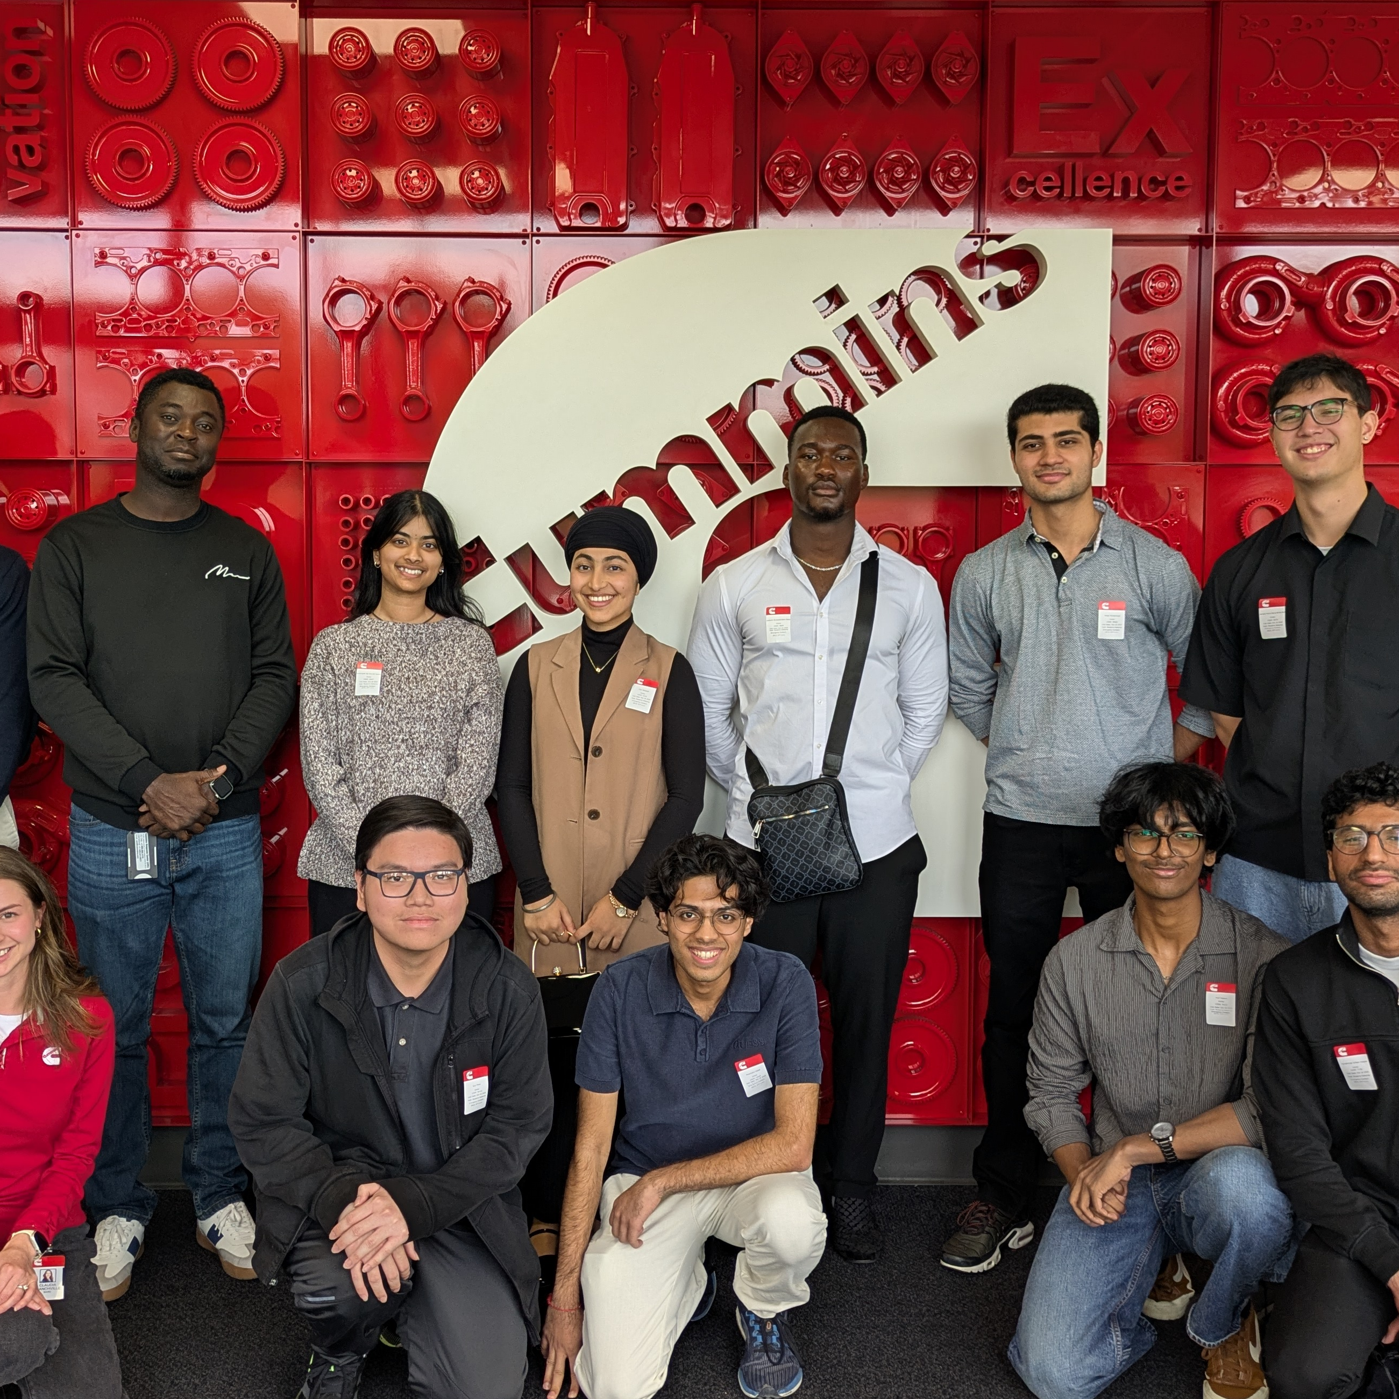

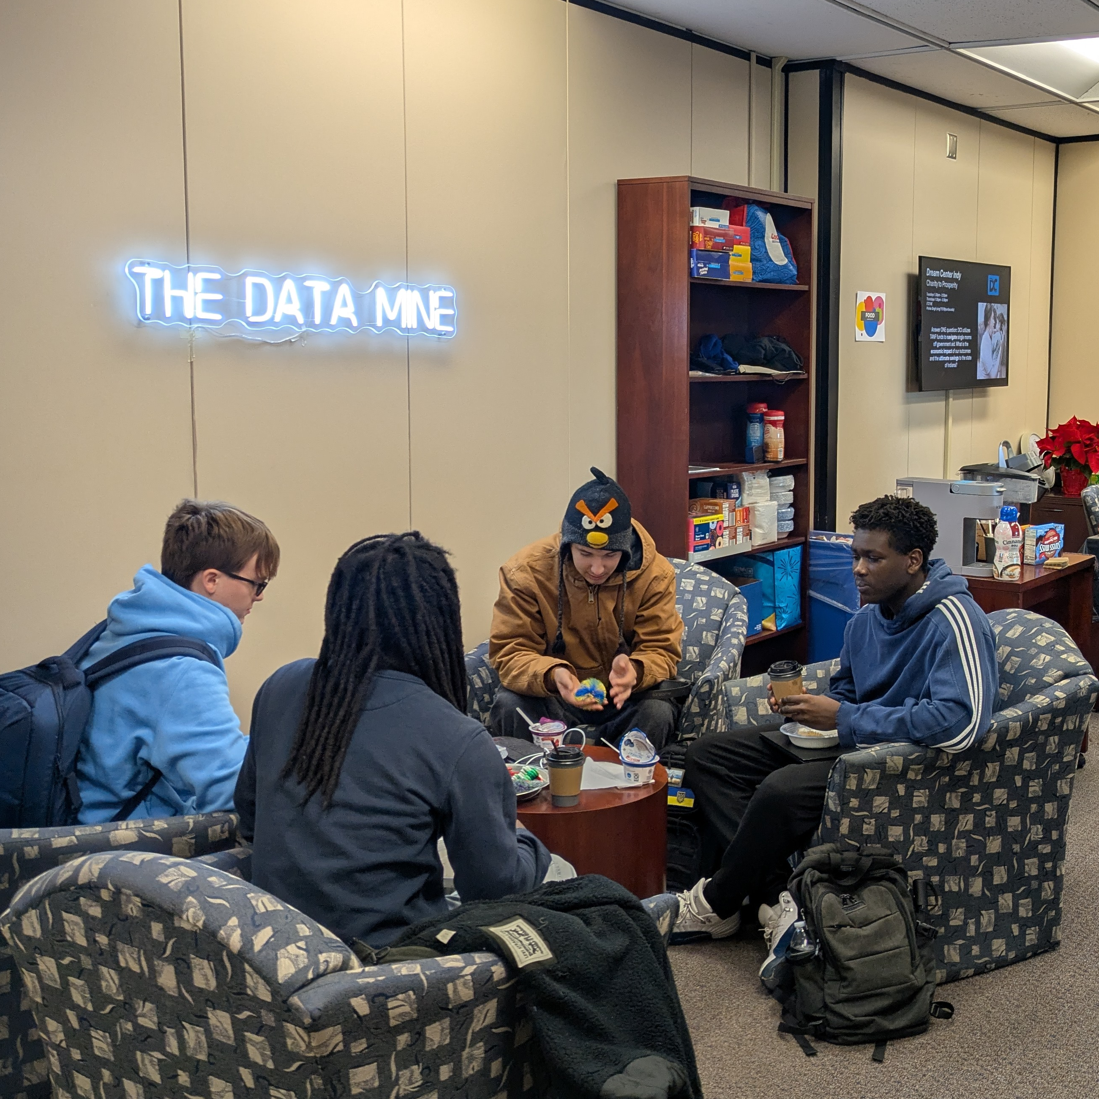


01000100 01100001 01110100 01100001 00100000 01101001 01110011 00100000 01110100 01101000 01100101 00100000 01101101 01101111 01110011 01110100 00100000 01110110 01100001 01101100 01110101 01100001 01100010 01101100 01100101 00100000 01110010 01100101 01110011 01101111 01110101 01110010 01100011 01100101 00100000 01101111 01101110 00100000 01000101 01100001 01110010 01110100 01101000 00101110 00100000 01000001 01110100 00100000 01010000 01110101 01110010 01100100 01110101 01100101 00101100 00100000 01110111 01100101 00100000 01100001 01110010 01100101 00100000 01100101 01111000 01110000 01101100 01101111 01110010 01101001 01101110 01100111 00100000 01101000 01101111 01110111 00100000 01110111 01100101 00100000 01100001 01101110 01100001 01101100 01111001 01111010 01100101 00100000 01101001 01110100 00101100 00100000 01101000 01101111 01110111 00100000 01110111 01100101 00100000 01100110 01101001 01101110 01100100 00100000 01101101 01100101 01100001 01101110 01101001 01101110 01100111 00100000 01101001 01101110 00100000 01101001 01110100 00100000 11100010 10000000 10010100 00100000 01100001 01101110 01100100 00100000 01101000 01101111 01110111 00100000 01110111 01100101 00100000 01110101 01110011 01100101 00100000 01101001 01110100 00100000 01110010 01100101 01110011 01110000 01101111 01101110 01110011 01101001 01100010 01101100 01111001 00101110 00100000 01000101 01101110 01110100 01100101 01110010 00100000 01010100 01101000 01100101 00100000 01000100 01100001 01110100 01100001 00100000 01001101 01101001 01101110 01100101 00101100 00100000 01100001 01101110 00100000 01101001 01101110 01110100 01100101 01110010 01100100 01101001 01110011 01100011 01101001 01110000 01101100 01101001 01101110 01100001 01110010 01111001 00100000 01101100 01101001 01110110 01101001 01101110 01100111 00101101 01101100 01100101 01100001 01110010 01101110 01101001 01101110 01100111 00100000 01100011 01101111 01101101 01101101 01110101 01101110 01101001 01110100 01111001 00100000 01101111 01110000 01100101 01101110 00100000 01110100 01101111 00100000 01110011 01110100 01110101 01100100 01100101 01101110 01110100 01110011 00100000 01100110 01110010 01101111 01101101 00100000 01100101 01110110 01100101 01110010 01111001 00100000 01100011 01101111 01101100 01101100 01100101 01100111 01100101 00101100 00100000 01110000 01110010 01101111 01100111 01110010 01100001 01101101 00100000 01100001 01101110 01100100 00100000 01101101 01100001 01101010 01101111 01110010 00100000 01100001 01100011 01110010 01101111 01110011 01110011 00100000 01010000 01110101 01110010 01100100 01110101 01100101 11100010 10000000 10011001 01110011 00100000 01100011 01100001 01101101 01110000 01110101 01110011 00101110 00001010 00001010 01010111 01101111 01110010 01101011 01101001 01101110 01100111 00100000 01100001 01101100 01101111 01101110 01100111 01110011 01101001 01100100 01100101 00100000 01100011 01101111 01110010 01110000 01101111 01110010 01100001 01110100 01100101 00100000 01101001 01101110 01100100 01110101 01110011 01110100 01110010 01111001 00100000 01101100 01100101 01100001 01100100 01100101 01110010 01110011 00101100 00100000 01100110 01100001 01100011 01110101 01101100 01110100 01111001 00100000 01100001 01101110 01100100 00100000 01101101 01100101 01101110 01110100 01101111 01110010 01110011 00101100 00100000 01010100 01101000 01100101 00100000 01000100 01100001 01110100 01100001 00100000 01001101 01101001 01101110 01100101 00100000 01110000 01110010 01100101 01110000 01100001 01110010 01100101 01110011 00100000 01110011 01110100 01110101 01100100 01100101 01101110 01110100 01110011 00100000 01110100 01101111 00100000 01110011 01101111 01101100 01110110 01100101 00100000 01110100 01101111 01100100 01100001 01111001 11100010 10000000 10011001 01110011 00100000 01110100 01101111 01110101 01100111 01101000 01100101 01110011 01110100 00100000 01100011 01101000 01100001 01101100 01101100 01100101 01101110 01100111 01100101 01110011 00100000 01110111 01101000 01101001 01101100 01100101 00100000 01110000 01101100 01100001 01101110 01101110 01101001 01101110 01100111 00100000 01100110 01101111 01110010 00100000 01110100 01101000 01100101 00100000 01101010 01101111 01100010 01110011 00100000 01101111 01100110 00100000 01110100 01101111 01101101 01101111 01110010 01110010 01101111 01110111 00101110 01000100 01100001 01110100 01100001 00100000 01101001 01110011 00100000 01110100 01101000 01100101 00100000 01101101 01101111 01110011 01110100 00100000 01110110 01100001 01101100 01110101 01100001 01100010 01101100 01100101 00100000 01110010 01100101 01110011 01101111 01110101 01110010 01100011 01100101 00100000 01101111 01101110 00100000 01000101 01100001 01110010 01110100 01101000 00101110 00100000 01000001 01110100 00100000 01010000 01110101 01110010 01100100 01110101 01100101 00101100 00100000 01110111 01100101 00100000 01100001 01110010 01100101 00100000 01100101 01111000 01110000 01101100 01101111 01110010 01101001 01101110 01100111 00100000 01101000 01101111 01110111 00100000 01110111 01100101 00100000 01100001 01101110 01100001 01101100 01111001 01111010 01100101 00100000 01101001 01110100 00101100 00100000 01101000 01101111 01110111 00100000 01110111 01100101 00100000 01100110 01101001 01101110 01100100 00100000 01101101 01100101 01100001 01101110 01101001 01101110 01100111 00100000 01101001 01101110 00100000 01101001 01110100 00100000 11100010 10000000 10010100 00100000 01100001 01101110 01100100 00100000 01101000 01101111 01110111 00100000 01110111 01100101 00100000 01110101 01110011 01100101 00100000 01101001 01110100 00100000 01110010 01100101 01110011 01110000 01101111 01101110 01110011 01101001 01100010 01101100 01111001 00101110 00100000 01000101 01101110 01110100 01100101 01110010 00100000 01010100 01101000 01100101 00100000 01000100 01100001 01110100 01100001 00100000 01001101 01101001 01101110 01100101 00101100 00100000 01100001 01101110 00100000 01101001 01101110 01110100 01100101 01110010 01100100 01101001 01110011 01100011 01101001 01110000 01101100 01101001 01101110 01100001 01110010 01111001 00100000 01101100 01101001 01110110 01101001 01101110 01100111 00101101 01101100 01100101 01100001 01110010 01101110 01101001 01101110 01100111 00100000 01100011 01101111 01101101 01101101 01110101 01101110 01101001 01110100 01111001 00100000 01101111 01110000 01100101 01101110 00100000 01110100 01101111 00100000 01110011 01110100 01110101 01100100 01100101 01101110 01110100 01110011 00100000 01100110 01110010 01101111 01101101 00100000 01100101 01110110 01100101 01110010 01111001 00100000 01100011 01101111 01101100 01101100 01100101 01100111 01100101 00101100 00100000 01110000 01110010 01101111 01100111 01110010 01100001 01101101 00100000 01100001 01101110 01100100 00100000 01101101 01100001 01101010 01101111 01110010 00100000 01100001 01100011 01110010 01101111 01110011 01110011 00100000 01010000 01110101 01110010 01100100 01110101 01100101 11100010 10000000 10011001 01110011 00100000 01100011 01100001 01101101 01110000 01110101 01110011 00101110 00001010 00001010 01010111 01101111 01110010 01101011 01101001 01101110 01100111 00100000 01100001 01101100 01101111 01101110 01100111 01110011 01101001 01100100 01100101 00100000 01100011 01101111 01110010 01110000 01101111 01110010 01100001 01110100 01100101 00100000 01101001 01101110 01100100 01110101 01110011 01110100 01110010 01111001 00100000 01101100 01100101 01100001 01100100 01100101 01110010 01110011 00101100 00100000 01100110 01100001 01100011 01110101 01101100 01110100 01111001 00100000 01100001 01101110 01100100 00100000 01101101 01100101 01101110 01110100 01101111 01110010 01110011 00101100 00100000 01010100 01101000 01100101 00100000 01000100 01100001 01110100 01100001 00100000 01001101 01101001 01101110 01100101 00100000 01110000 01110010 01100101 01110000 01100001 01110010 01100101 01110011 00100000 01110011 01110100 01110101 01100100 01100101 01101110 01110100 01110011 00100000 01110100 01101111 00100000 01110011 01101111 01101100 01110110 01100101 00100000 01110100 01101111 01100100 01100001 01111001 11100010 10000000 10011001 01110011 00100000 01110100 01101111 01110101 01100111 01101000 01100101 01110011 01110100 00100000 01100011 01101000 01100001 01101100 01101100 01100101 01101110 01100111 01100101 01110011 00100000 01110111 01101000 01101001 01101100 01100101 00100000 01110000 01101100 01100001 01101110 01101110 01101001 01101110 01100111 00100000 01100110 01101111 01110010 00100000 01110100 01101000 01100101 00100000 01101010 01101111 01100010 01110011 00100000 01101111 01100110 00100000 01110100 01101111 01101101 01101111 01110010 01110010 01101111 01110111 00101110 01000010 01110010 01111001 01100011 01100101 00100000 01000011 01100001 01110011 01110100 01101100 01100101 00100000 01000000 00100000 01010100 01101000 01100101 00100000 01000100 01100001 01110100 01100001 00100000 01001101 01101001 01101110 01100101 01000010 01110010 01111001 01100011 01100101 00100000 01000011 01100001 01110011 01110100 01101100 01100101 00100000 01000000 00100000 01010100 01101000 01100101 00100000 01000100 01100001 01110100 01100001 00100000 01001101 01101001 01101110 01100101 01000010 01110010 01111001 01100011 01100101 00100000 01000011 01100001 01110011 01110100 01101100
Apply for The Data Mine! 2026-27 Academic Year
Corporate Partners
Work with a company on a data-driven project
Teams of 8-10 students
3 Credit Hours + Seminar
https://datamine.purdue.edu/apply/
Seminar
Work on a high-performance compute cluster
Learn data science topics
1 Credit Hour
OPEN TO ALL MAJORS AND GRADE LEVELS

Slide 13

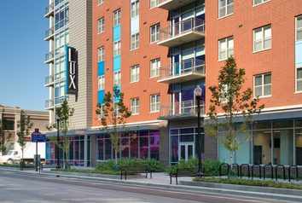
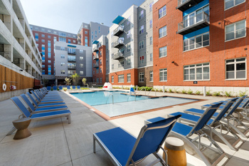

STAY SMART THIS SUMMER IN INDIANAPOLIS:
SUMMER INTERN HOUSING
SUMMER INTERN HOUSING
Make your summer internship a success with Purdue University Residences’ comfortable and convenient housing.
Private bedroom/bathroom within four-person apartment
Fully Furnished
Full Kitchen
In-unit Laundry
On Site Pool, Gym, Courtyard
Live-In Staff Support
24/7 Access Control
Gated Parking Garage (optional)
Downtown Location
One block from IndyGo bus lines (Red, Green, Purple)
PRICING
$75 non-refundable application fee
Each resident must be at least 18 years of age, enrolled in an internship at Purdue University or the greater Indianapolis area, enrolled in a higher education, degree-seeking program and must abide by the guidelines of behavior for University Residences.
$329/week for Purdue students
$371/week for non-Purdue students
For more information, visit: tinyurl.com/indyintern
/UniversityResidences
@reslifeatpurdue
housing.purdue.edu/my-housing/indy

Slide 14
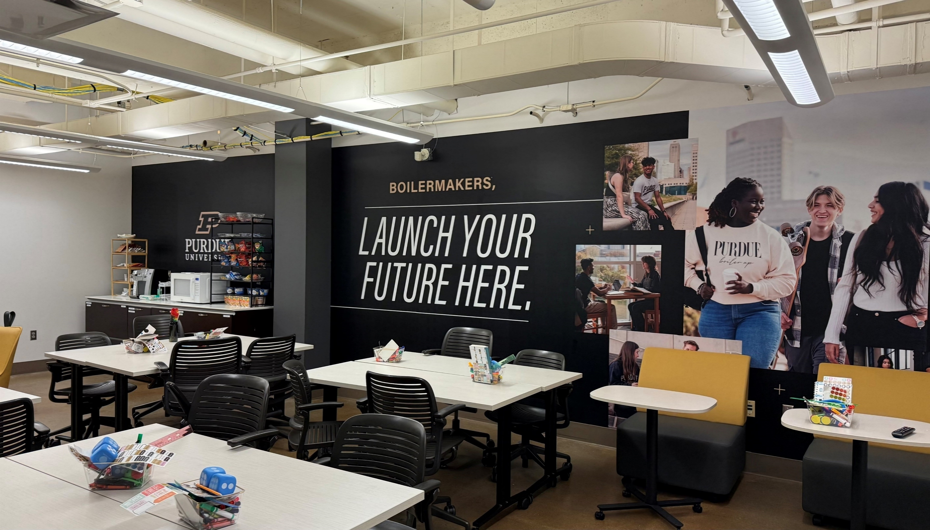


THE LAUNCH PAD
Spring 2026 CALENDAR
January - March
Wed. 01/28
Welcome Back: Finding your people
4-6 pm; The Launch Pad ET 002
Wed. 02/11
Community belonging night
2-6pm; The Launch Pad ET 002
Wed. 02/25
Leave your LEGO Legacy
12-3pm: The Launch Pad ET 002
Wed. 03/11
March Madness: Bracket Kickoff
4-6pm; The Launch Pad ET 002
3/30 – 04/6
March Madness: Watch Party Week
Join the Launch Pad March Madness Brackett Challenge! Scan the QR code, make your picks, and check back for weekly updates and prizes

Slide 15


LEARN MORE & APPLY ONLINE AT: www.indytransportationclub.com/scholarship
HOW TO APPLY​
Submit an application form online ​
Write an essay ​
Provide a recommendation letter​
Are you a Purdue Motorsports Engineering student whose degree could be impacted by Supply Chain Logistics or Transportation?
Apply now for the Indianapolis Transportation Club's annual scholarship!
Scholarships will be awarded at the ITC Annual Dinner in December
Applications are open until October 31st

Slide 16


Slide 17




INNOVATE INDY Purdue Engineering Graduate & Postdoc Research Symposium
Graduate Students & Postdocs:
Present your work at the Innovate Indy Symposium!
April 24 | 12:30–4:30 PM Skyline Club at OneAmerica Tower Indianapolis
Sign up on our website:

Slide 18
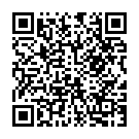

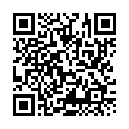

EPICS & VIP Pre-Registration Now Open
Through March 25, 2026
Why Should I Enroll?
EPICS and VIP provide real world experience and great discussion points for job interviews.
Why Should I Enroll?
EPICS and VIP provide real world experience and great discussion points for job interviews.
Why Should I Pre-Register?
Apply now to get on the team that best matches your interests.
Apply for EPICS if you are interested in a project that supports local community and education organizations.
Apply for VIP if you are interested in design projects related to active research and national, international and industry-sponsored design challenges.
Open to All Majors and Grade Levels
1 or 2 credit hours

Slide 19


Slide 20


Slide 21

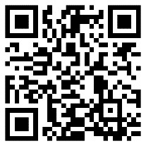
Student Trailblazer Fund
Help your student organization launch, accelerate, and chart new paths toward the future in Indianapolis!
Available to Recognized Student Organizations (RSOs) in Indianapolis
The next application deadline is March 30 (for summer expenses: May 1-June 30)
Learn more and apply in Boilerlink
From your RSO page, click Finance
Click Create a Budget Request
Complete the Trailblazer Application Cycle 2
For questions or more information, visit the Student Life Office in ET 331 or email studentlifeindy@purdue.edu

Slide 22
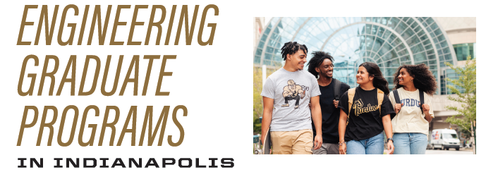


Pursue your Master’s Degree in Indianapolis!
Apply now! Final Deadlines early March/April 2026
Notes:
22

Slide 24


Slide 25


Slide 26


Slide 28
Dr. Satish Boregowda, PhD - Seminar
Human Stress Modeling for Sports Engineering: Making a Case for Human-Centered Design
Date: Friday, March 27th
Time: 10:00 A.M.
Room: Dallara Indycar Factory

Slide 29


Slide 30





IGNITE x CCO Lunch & Learn Series Session 2: Resume Review Workshop
Session 2: 📅 Thursday, April 9 |
🕛 12:00 PM ET 103 🍕 Pizza provided
RSVP by April 7 !
Scan and RSVP:
Bring your resume/CV, grab pizza, and receive personalized resume feedback from Purdue CCO advisors.
Update your resume, strengthen your applications, and get ready for internships and industry jobs!
Hosted by: IGNITE (Indianapolis Graduate Network for Innovation, Training, & Engineering) & CCO (Center for Career Opportunities)

