Slide 1


Slide 2
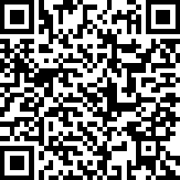
Mechanical Engineering Student Forum (Indy)
Thursday, April 30 | 5:30pm in IO 101
Use this QR code if you’d like to submit questions ahead of time.
All students are welcome to join the Mechanical Engineering Student Forum (Indy) hosted by ASME.
Pizza will be served for guests* followed by pre-submitted questions, and then an open Q&A.
*While supplies last

Slide 3


Slide 4


Slide 5

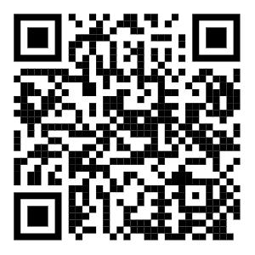
Academic Poster Printing
Printer Service for Poster/Plotter
Send all Poster Requests to:
printindy@purdue.edu

Slide 6


Slide 7

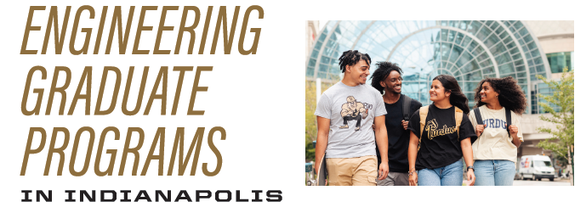


Pursue your Master’s Degree in Indianapolis!
Apply now!
Final Deadlines early March/April 2026
Notes:
7

Slide 9



Slide 10


Slide 11




Collaborative Leadership Certificate
Open to all majors – new courses in Indianapolis!
EDPS 31500
Interpersonal Skills
EDPS 31600
Cross-Cultural Settings
EDPS 31700
Mentoring
Experiential, case‑based course exploring motivation and systems theory, with practical skill‑building in conducting difficult workplace conversations.
Examines cultural dimensions of leadership in the U.S. and globally.
Overview of mentoring as a core skill in collaborative leadership, featuring a semester‑long service‑learning experience pairing students with undergraduate mentees through weekly mentoring sessions. Builds knowledge, skills, and dispositions for effective peer mentorship.
Meets Oral Communication (OC) foundational requirement.
Meets Human Cultures: Behavioral Social Sciences (BBS) requirement.
Contact your academic advisor for more information!

Slide 12
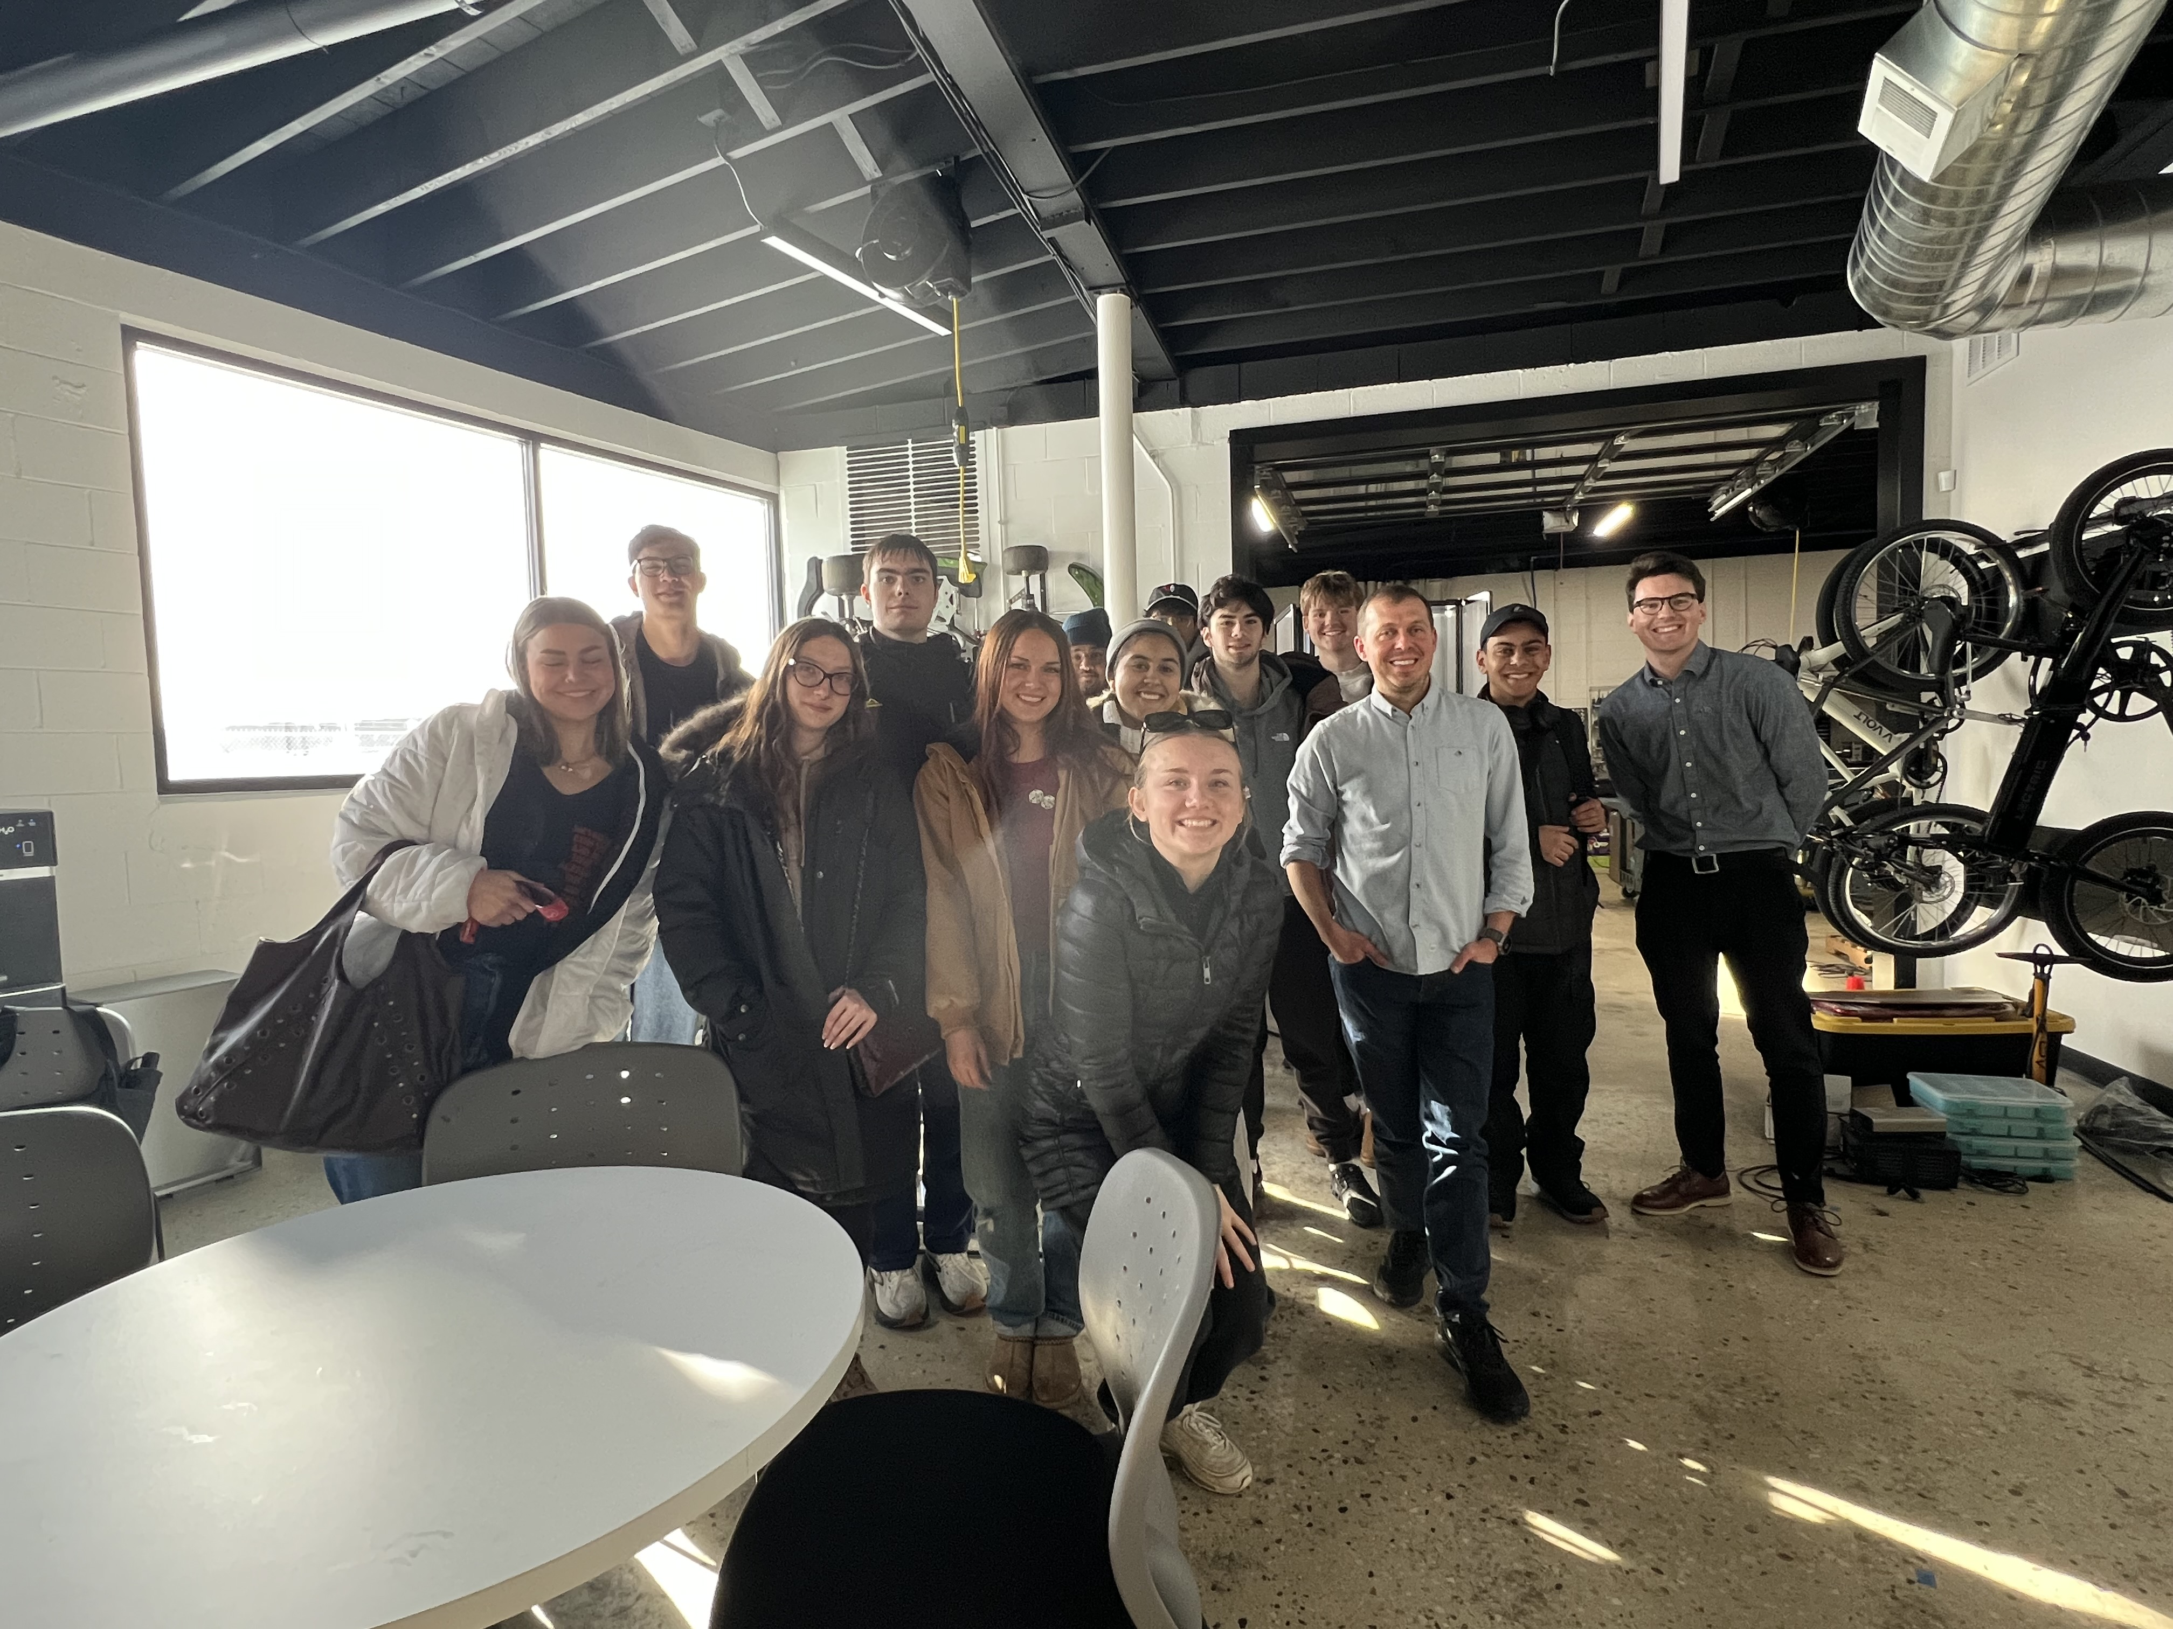
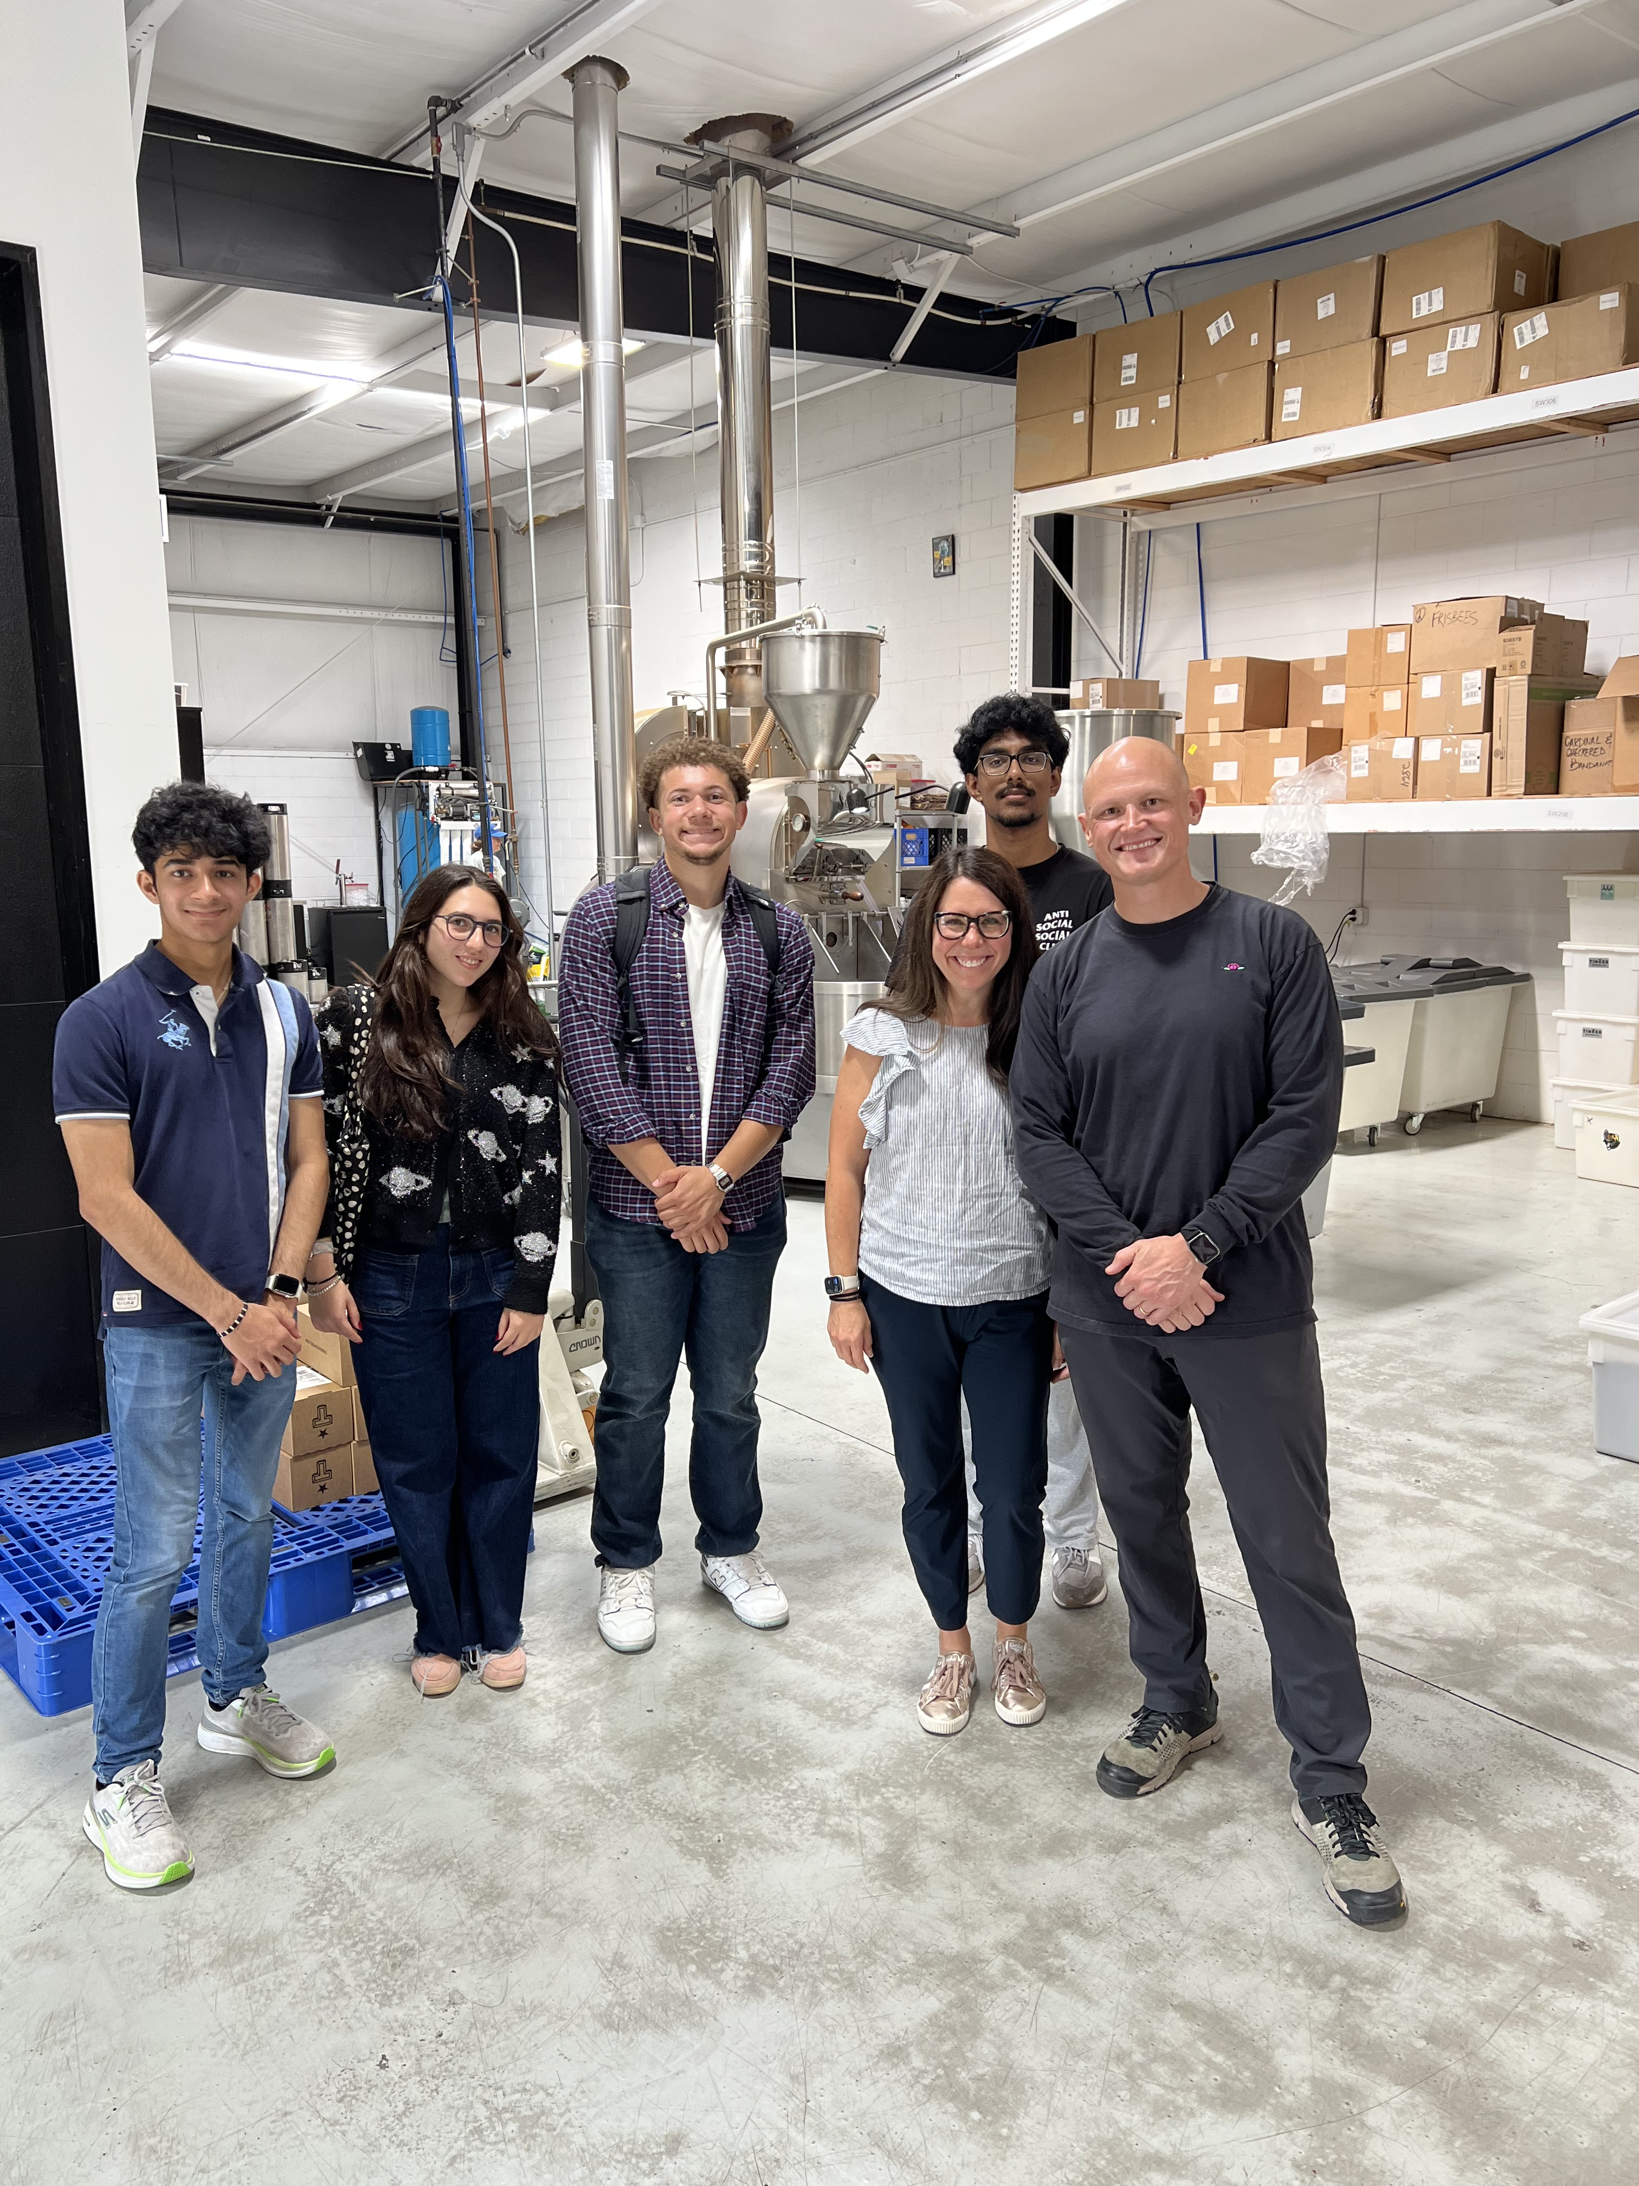

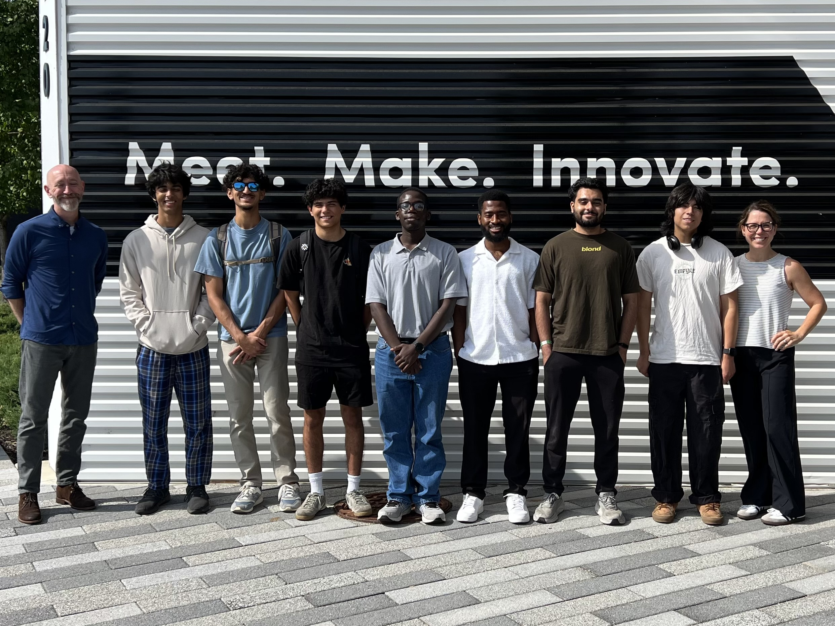

Start your Purdue Certificate in Entrepreneurship Fall 2026
Register for ENTR 20000
Tuesday/Thursday: 9:00 to 10:45
OR
Tuesday/Thursday: 1:30 to 2:45

Slide 13
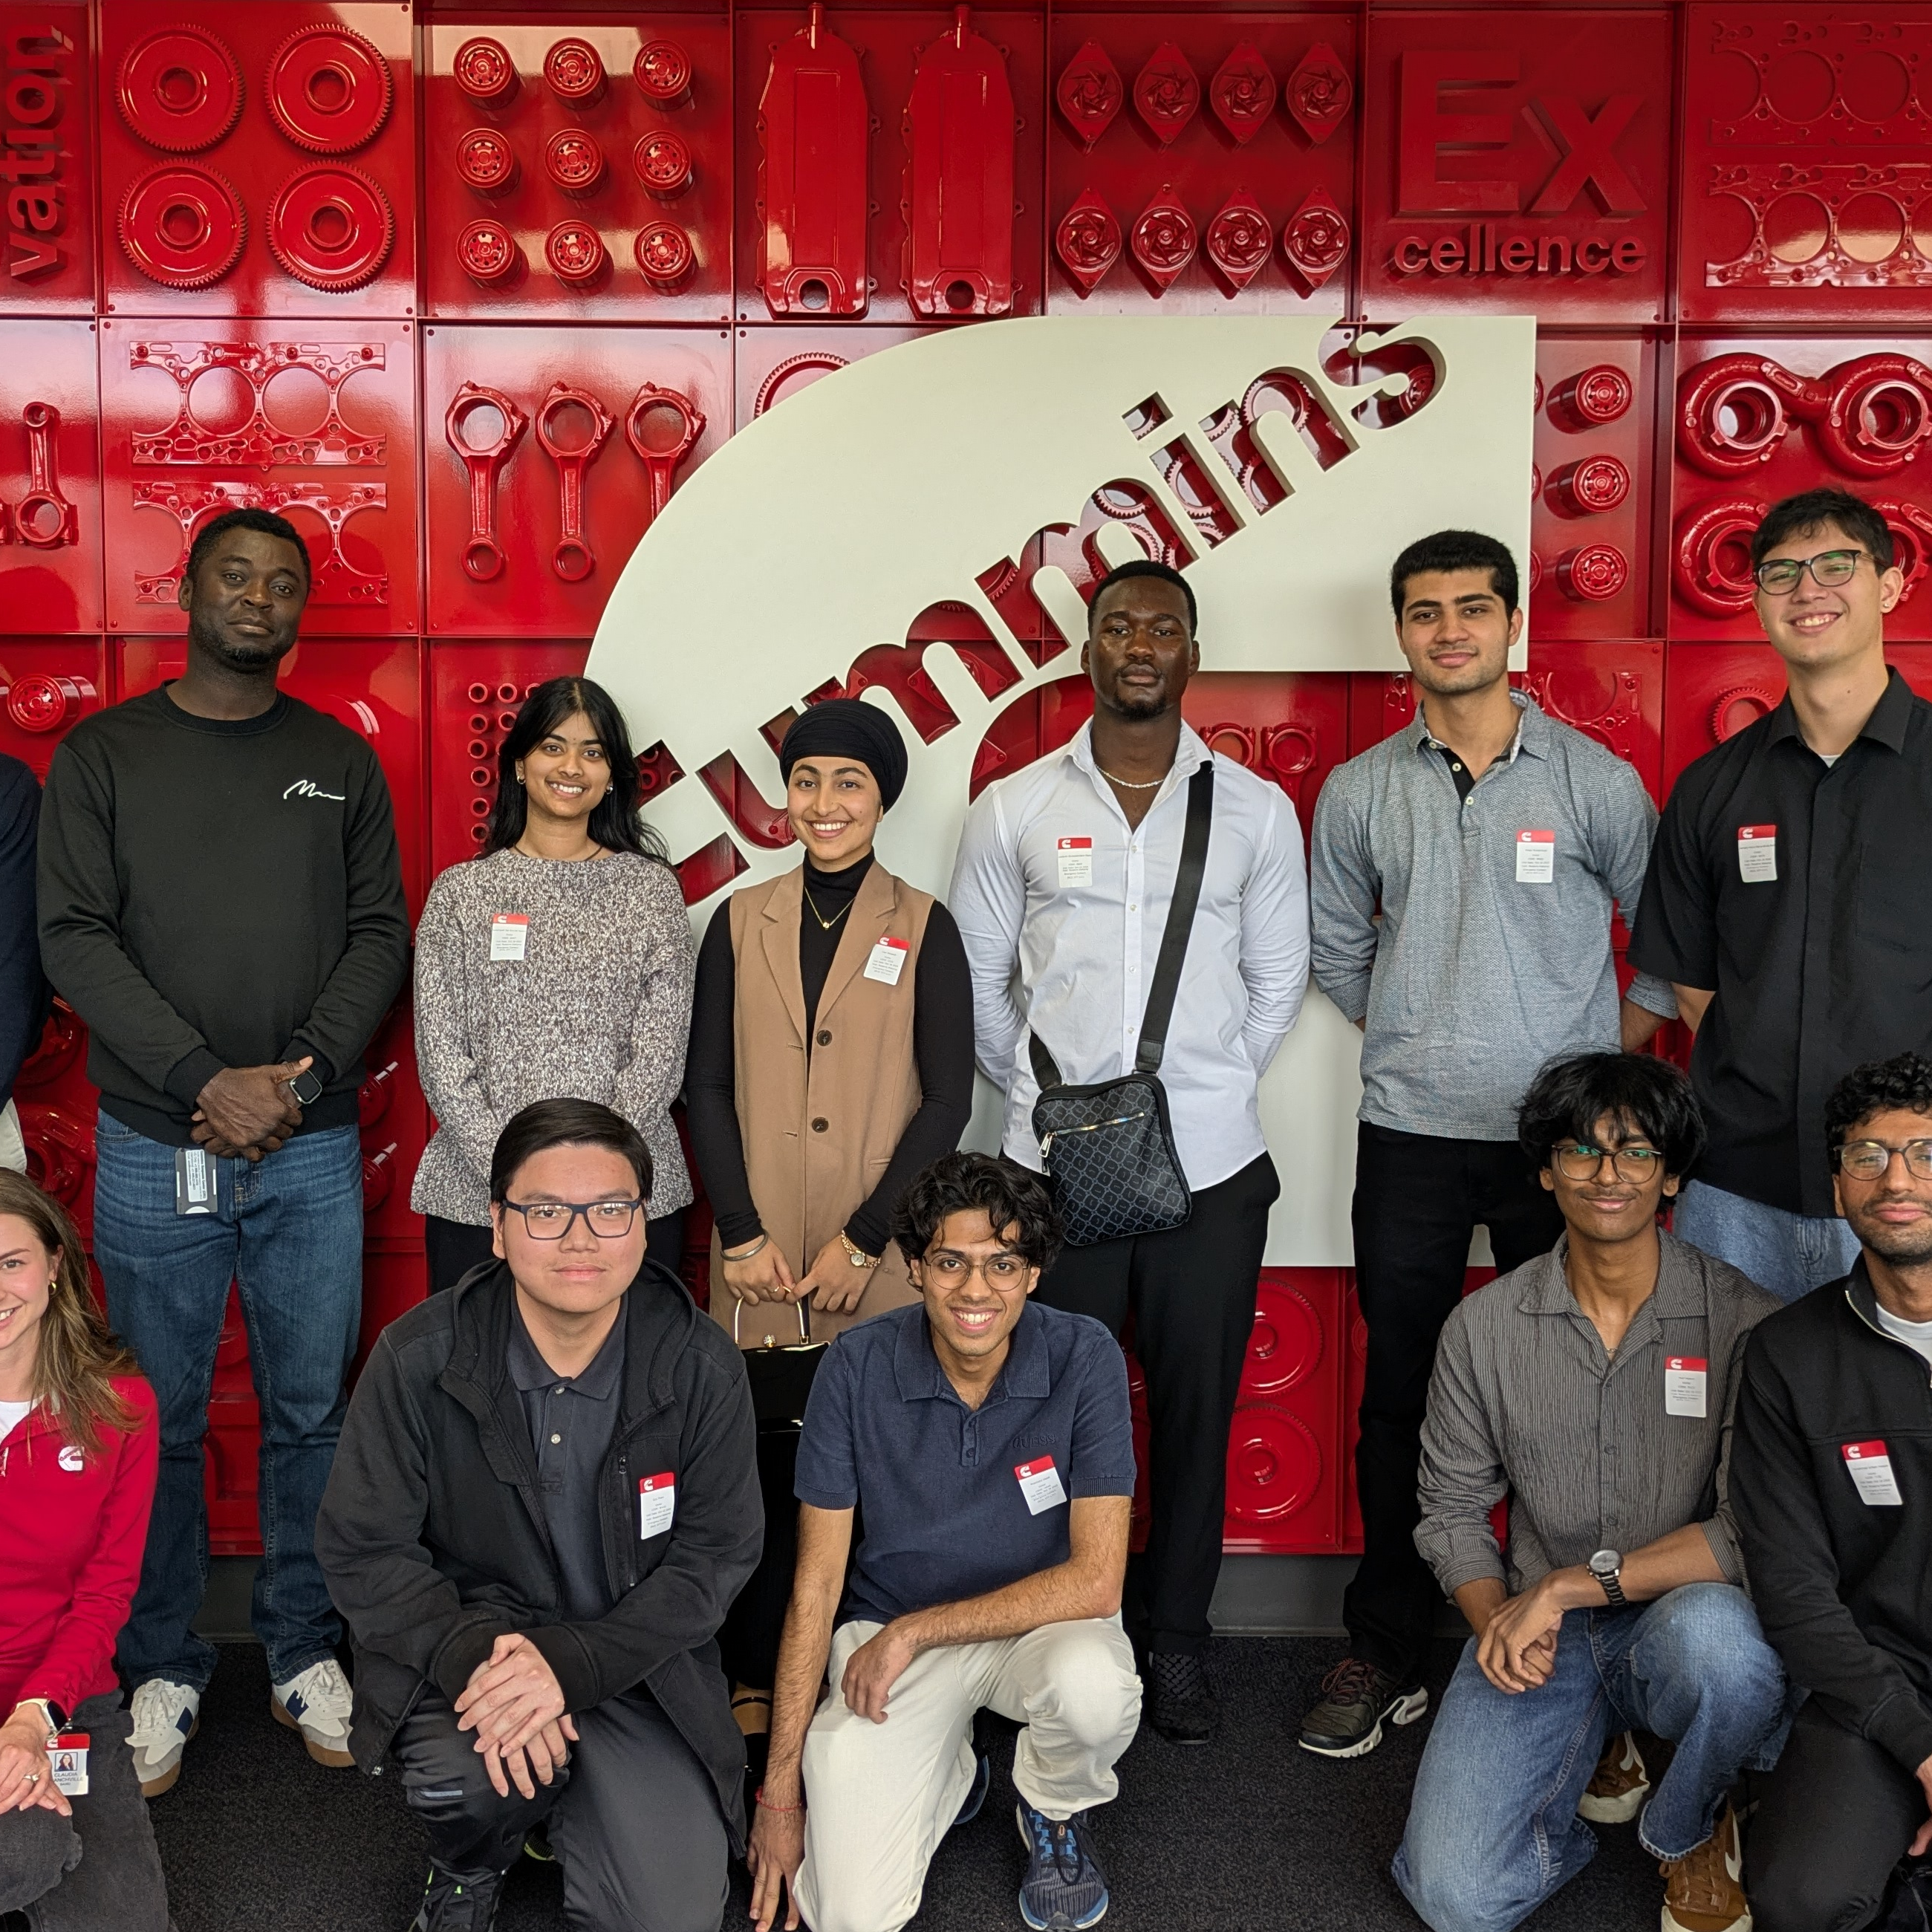
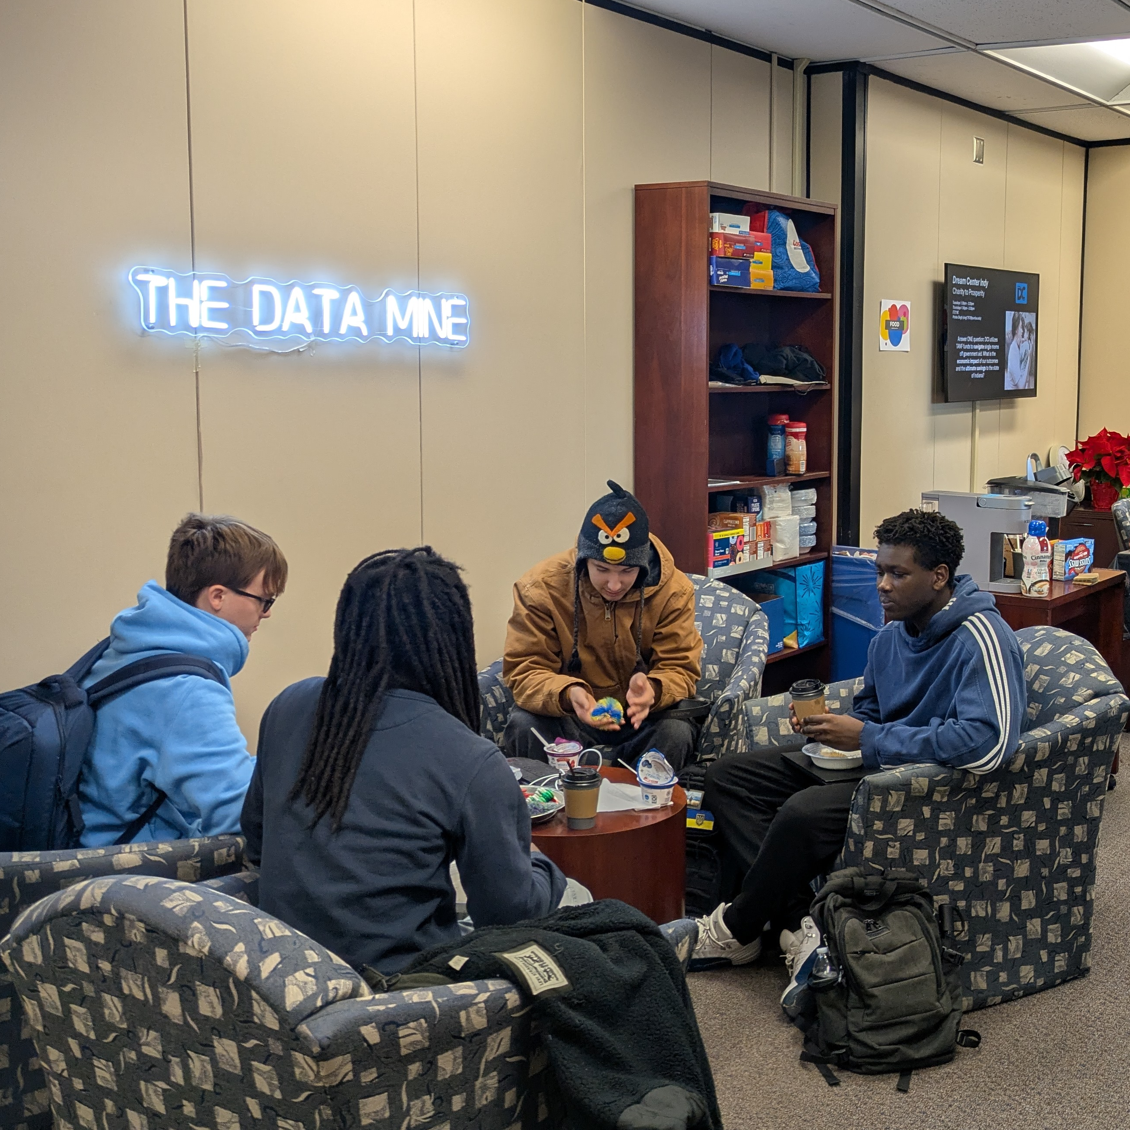


01000100 01100001 01110100 01100001 00100000 01101001 01110011 00100000 01110100 01101000 01100101 00100000 01101101 01101111 01110011 01110100 00100000 01110110 01100001 01101100 01110101 01100001 01100010 01101100 01100101 00100000 01110010 01100101 01110011 01101111 01110101 01110010 01100011 01100101 00100000 01101111 01101110 00100000 01000101 01100001 01110010 01110100 01101000 00101110 00100000 01000001 01110100 00100000 01010000 01110101 01110010 01100100 01110101 01100101 00101100 00100000 01110111 01100101 00100000 01100001 01110010 01100101 00100000 01100101 01111000 01110000 01101100 01101111 01110010 01101001 01101110 01100111 00100000 01101000 01101111 01110111 00100000 01110111 01100101 00100000 01100001 01101110 01100001 01101100 01111001 01111010 01100101 00100000 01101001 01110100 00101100 00100000 01101000 01101111 01110111 00100000 01110111 01100101 00100000 01100110 01101001 01101110 01100100 00100000 01101101 01100101 01100001 01101110 01101001 01101110 01100111 00100000 01101001 01101110 00100000 01101001 01110100 00100000 11100010 10000000 10010100 00100000 01100001 01101110 01100100 00100000 01101000 01101111 01110111 00100000 01110111 01100101 00100000 01110101 01110011 01100101 00100000 01101001 01110100 00100000 01110010 01100101 01110011 01110000 01101111 01101110 01110011 01101001 01100010 01101100 01111001 00101110 00100000 01000101 01101110 01110100 01100101 01110010 00100000 01010100 01101000 01100101 00100000 01000100 01100001 01110100 01100001 00100000 01001101 01101001 01101110 01100101 00101100 00100000 01100001 01101110 00100000 01101001 01101110 01110100 01100101 01110010 01100100 01101001 01110011 01100011 01101001 01110000 01101100 01101001 01101110 01100001 01110010 01111001 00100000 01101100 01101001 01110110 01101001 01101110 01100111 00101101 01101100 01100101 01100001 01110010 01101110 01101001 01101110 01100111 00100000 01100011 01101111 01101101 01101101 01110101 01101110 01101001 01110100 01111001 00100000 01101111 01110000 01100101 01101110 00100000 01110100 01101111 00100000 01110011 01110100 01110101 01100100 01100101 01101110 01110100 01110011 00100000 01100110 01110010 01101111 01101101 00100000 01100101 01110110 01100101 01110010 01111001 00100000 01100011 01101111 01101100 01101100 01100101 01100111 01100101 00101100 00100000 01110000 01110010 01101111 01100111 01110010 01100001 01101101 00100000 01100001 01101110 01100100 00100000 01101101 01100001 01101010 01101111 01110010 00100000 01100001 01100011 01110010 01101111 01110011 01110011 00100000 01010000 01110101 01110010 01100100 01110101 01100101 11100010 10000000 10011001 01110011 00100000 01100011 01100001 01101101 01110000 01110101 01110011 00101110 00001010 00001010 01010111 01101111 01110010 01101011 01101001 01101110 01100111 00100000 01100001 01101100 01101111 01101110 01100111 01110011 01101001 01100100 01100101 00100000 01100011 01101111 01110010 01110000 01101111 01110010 01100001 01110100 01100101 00100000 01101001 01101110 01100100 01110101 01110011 01110100 01110010 01111001 00100000 01101100 01100101 01100001 01100100 01100101 01110010 01110011 00101100 00100000 01100110 01100001 01100011 01110101 01101100 01110100 01111001 00100000 01100001 01101110 01100100 00100000 01101101 01100101 01101110 01110100 01101111 01110010 01110011 00101100 00100000 01010100 01101000 01100101 00100000 01000100 01100001 01110100 01100001 00100000 01001101 01101001 01101110 01100101 00100000 01110000 01110010 01100101 01110000 01100001 01110010 01100101 01110011 00100000 01110011 01110100 01110101 01100100 01100101 01101110 01110100 01110011 00100000 01110100 01101111 00100000 01110011 01101111 01101100 01110110 01100101 00100000 01110100 01101111 01100100 01100001 01111001 11100010 10000000 10011001 01110011 00100000 01110100 01101111 01110101 01100111 01101000 01100101 01110011 01110100 00100000 01100011 01101000 01100001 01101100 01101100 01100101 01101110 01100111 01100101 01110011 00100000 01110111 01101000 01101001 01101100 01100101 00100000 01110000 01101100 01100001 01101110 01101110 01101001 01101110 01100111 00100000 01100110 01101111 01110010 00100000 01110100 01101000 01100101 00100000 01101010 01101111 01100010 01110011 00100000 01101111 01100110 00100000 01110100 01101111 01101101 01101111 01110010 01110010 01101111 01110111 00101110 01000100 01100001 01110100 01100001 00100000 01101001 01110011 00100000 01110100 01101000 01100101 00100000 01101101 01101111 01110011 01110100 00100000 01110110 01100001 01101100 01110101 01100001 01100010 01101100 01100101 00100000 01110010 01100101 01110011 01101111 01110101 01110010 01100011 01100101 00100000 01101111 01101110 00100000 01000101 01100001 01110010 01110100 01101000 00101110 00100000 01000001 01110100 00100000 01010000 01110101 01110010 01100100 01110101 01100101 00101100 00100000 01110111 01100101 00100000 01100001 01110010 01100101 00100000 01100101 01111000 01110000 01101100 01101111 01110010 01101001 01101110 01100111 00100000 01101000 01101111 01110111 00100000 01110111 01100101 00100000 01100001 01101110 01100001 01101100 01111001 01111010 01100101 00100000 01101001 01110100 00101100 00100000 01101000 01101111 01110111 00100000 01110111 01100101 00100000 01100110 01101001 01101110 01100100 00100000 01101101 01100101 01100001 01101110 01101001 01101110 01100111 00100000 01101001 01101110 00100000 01101001 01110100 00100000 11100010 10000000 10010100 00100000 01100001 01101110 01100100 00100000 01101000 01101111 01110111 00100000 01110111 01100101 00100000 01110101 01110011 01100101 00100000 01101001 01110100 00100000 01110010 01100101 01110011 01110000 01101111 01101110 01110011 01101001 01100010 01101100 01111001 00101110 00100000 01000101 01101110 01110100 01100101 01110010 00100000 01010100 01101000 01100101 00100000 01000100 01100001 01110100 01100001 00100000 01001101 01101001 01101110 01100101 00101100 00100000 01100001 01101110 00100000 01101001 01101110 01110100 01100101 01110010 01100100 01101001 01110011 01100011 01101001 01110000 01101100 01101001 01101110 01100001 01110010 01111001 00100000 01101100 01101001 01110110 01101001 01101110 01100111 00101101 01101100 01100101 01100001 01110010 01101110 01101001 01101110 01100111 00100000 01100011 01101111 01101101 01101101 01110101 01101110 01101001 01110100 01111001 00100000 01101111 01110000 01100101 01101110 00100000 01110100 01101111 00100000 01110011 01110100 01110101 01100100 01100101 01101110 01110100 01110011 00100000 01100110 01110010 01101111 01101101 00100000 01100101 01110110 01100101 01110010 01111001 00100000 01100011 01101111 01101100 01101100 01100101 01100111 01100101 00101100 00100000 01110000 01110010 01101111 01100111 01110010 01100001 01101101 00100000 01100001 01101110 01100100 00100000 01101101 01100001 01101010 01101111 01110010 00100000 01100001 01100011 01110010 01101111 01110011 01110011 00100000 01010000 01110101 01110010 01100100 01110101 01100101 11100010 10000000 10011001 01110011 00100000 01100011 01100001 01101101 01110000 01110101 01110011 00101110 00001010 00001010 01010111 01101111 01110010 01101011 01101001 01101110 01100111 00100000 01100001 01101100 01101111 01101110 01100111 01110011 01101001 01100100 01100101 00100000 01100011 01101111 01110010 01110000 01101111 01110010 01100001 01110100 01100101 00100000 01101001 01101110 01100100 01110101 01110011 01110100 01110010 01111001 00100000 01101100 01100101 01100001 01100100 01100101 01110010 01110011 00101100 00100000 01100110 01100001 01100011 01110101 01101100 01110100 01111001 00100000 01100001 01101110 01100100 00100000 01101101 01100101 01101110 01110100 01101111 01110010 01110011 00101100 00100000 01010100 01101000 01100101 00100000 01000100 01100001 01110100 01100001 00100000 01001101 01101001 01101110 01100101 00100000 01110000 01110010 01100101 01110000 01100001 01110010 01100101 01110011 00100000 01110011 01110100 01110101 01100100 01100101 01101110 01110100 01110011 00100000 01110100 01101111 00100000 01110011 01101111 01101100 01110110 01100101 00100000 01110100 01101111 01100100 01100001 01111001 11100010 10000000 10011001 01110011 00100000 01110100 01101111 01110101 01100111 01101000 01100101 01110011 01110100 00100000 01100011 01101000 01100001 01101100 01101100 01100101 01101110 01100111 01100101 01110011 00100000 01110111 01101000 01101001 01101100 01100101 00100000 01110000 01101100 01100001 01101110 01101110 01101001 01101110 01100111 00100000 01100110 01101111 01110010 00100000 01110100 01101000 01100101 00100000 01101010 01101111 01100010 01110011 00100000 01101111 01100110 00100000 01110100 01101111 01101101 01101111 01110010 01110010 01101111 01110111 00101110 01000010 01110010 01111001 01100011 01100101 00100000 01000011 01100001 01110011 01110100 01101100 01100101 00100000 01000000 00100000 01010100 01101000 01100101 00100000 01000100 01100001 01110100 01100001 00100000 01001101 01101001 01101110 01100101 01000010 01110010 01111001 01100011 01100101 00100000 01000011 01100001 01110011 01110100 01101100 01100101 00100000 01000000 00100000 01010100 01101000 01100101 00100000 01000100 01100001 01110100 01100001 00100000 01001101 01101001 01101110 01100101 01000010 01110010 01111001 01100011 01100101 00100000 01000011 01100001 01110011 01110100 01101100
Apply for The Data Mine!
2026-27 Academic Year
Corporate Partners
Work with a company on
a data-driven project
Teams of 8-10 students
3 Credit Hours + Seminar
https://datamine.purdue.edu/apply/
Seminar
Work on a high-performance compute cluster
Learn data science topics
1 Credit Hour
OPEN TO ALL MAJORS AND GRADE LEVELS

Slide 15

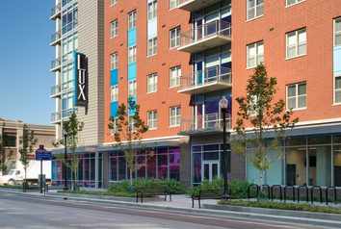
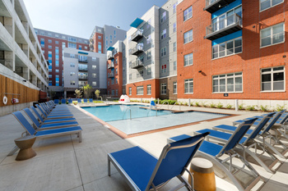

STAY SMART THIS SUMMER IN INDIANAPOLIS:
SUMMER INTERN HOUSING
SUMMER INTERN HOUSING
Make your summer internship a success with Purdue University Residences’ comfortable and convenient housing.
Private bedroom/bathroom within four-person apartment
Fully Furnished
Full Kitchen
In-unit Laundry
On Site Pool, Gym, Courtyard
Live-In Staff Support
24/7 Access Control
Gated Parking Garage (optional)
Downtown Location
One block from IndyGo bus lines
(Red, Green, Purple)
PRICING
$75 non-refundable application fee
Each resident must be at least 18 years of age, enrolled in an internship at Purdue University or the greater Indianapolis area, enrolled in a higher education, degree-seeking program and must abide by the guidelines of behavior for University Residences.
$329/week for Purdue students
$371/week for non-Purdue students
For more information, visit: tinyurl.com/indyintern
/UniversityResidences
@reslifeatpurdue
housing.purdue.edu/my-housing/indy

Slide 16


LEARN MORE & APPLY ONLINE AT: www.indytransportationclub.com/scholarship
HOW TO APPLY​
Submit an application form online ​
Write an essay ​
Provide a recommendation letter​
Are you a Purdue Motorsports Engineering student whose degree could be impacted
by Supply Chain Logistics or Transportation?
Apply now for the Indianapolis Transportation Club's annual scholarship!
Scholarships will be awarded at the ITC Annual Dinner in December
Applications are open until October 31st

Slide 17


Slide 18


Slide 19


Slide 20

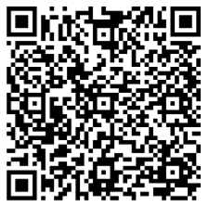
INDY AMPLIFIED: Summer in the Circle City
TRANSFORM YOUR SUMMER EXPERIENCE IN INDIANAPOLIS
Build Professional Skills
Create a Network
Explore the City
The single most TRANSFORMATIVE SKILL I gained is PURPOSE-DRIVEN NETWORKING. Indy Amplified taught me to move beyond polite introductions toward building sustained, mutually beneficial relationships."
Raja Ali
Summer 2025 Program Graduate
Learn more & Apply before April 15

Slide 21

Turn Your Skills
Into A Job Offer
Fall 2026 - Take Purdue Polytechnics
Professional Development course
Meet industry professionals
Learn skills in resume and interviewing
Connect with the city
For Polytechnic students only – Instructor approval
TCM 25000 – 1 Credit
Wednesdays - 3:30pm - 4:20pm

Slide 22


























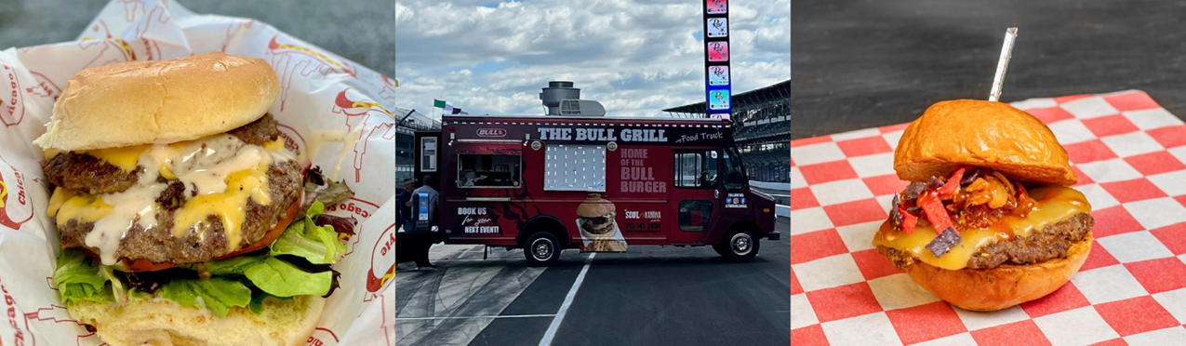
BOILER FUEL UP
April 30, 2026 - 11:00 AM - 3:00 PM
Get lunch from The Bull Grill Food Truck in Boiler Park!

Slide 23


Slide 24


Slide 25


Slide 26


Slide 27
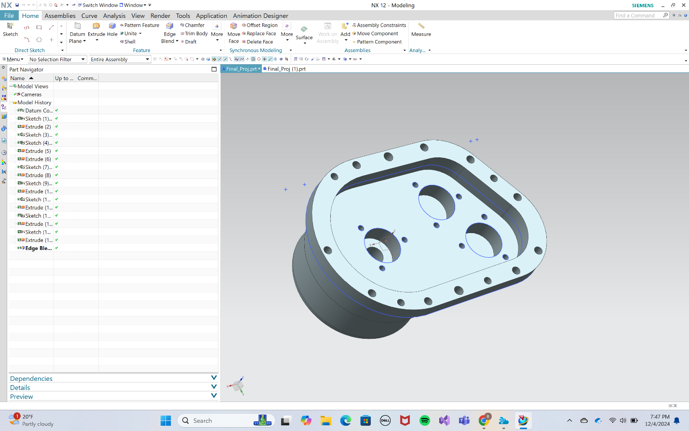
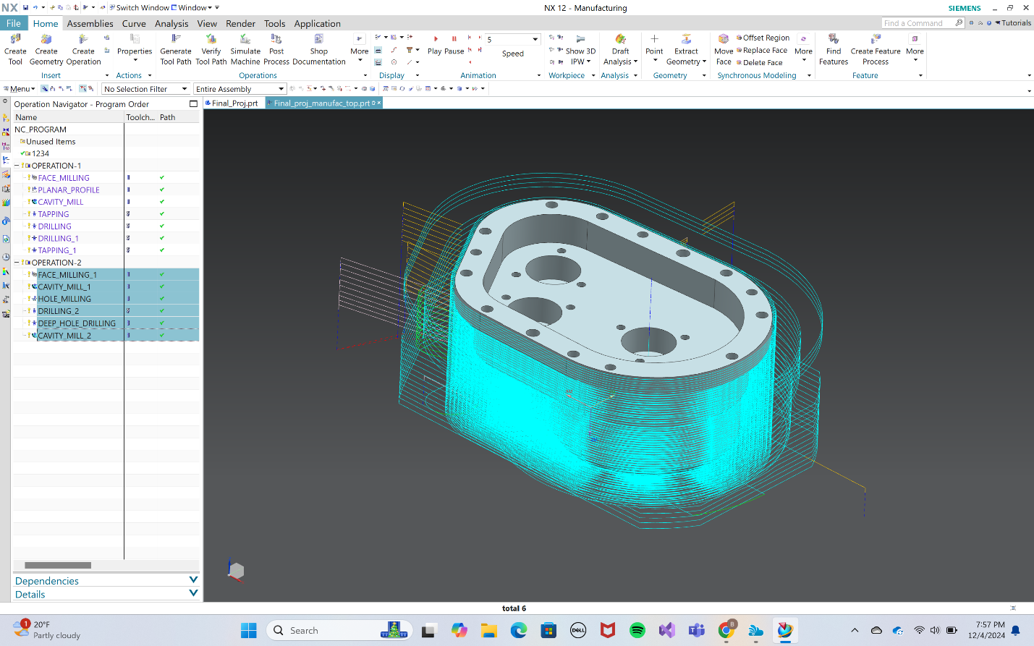
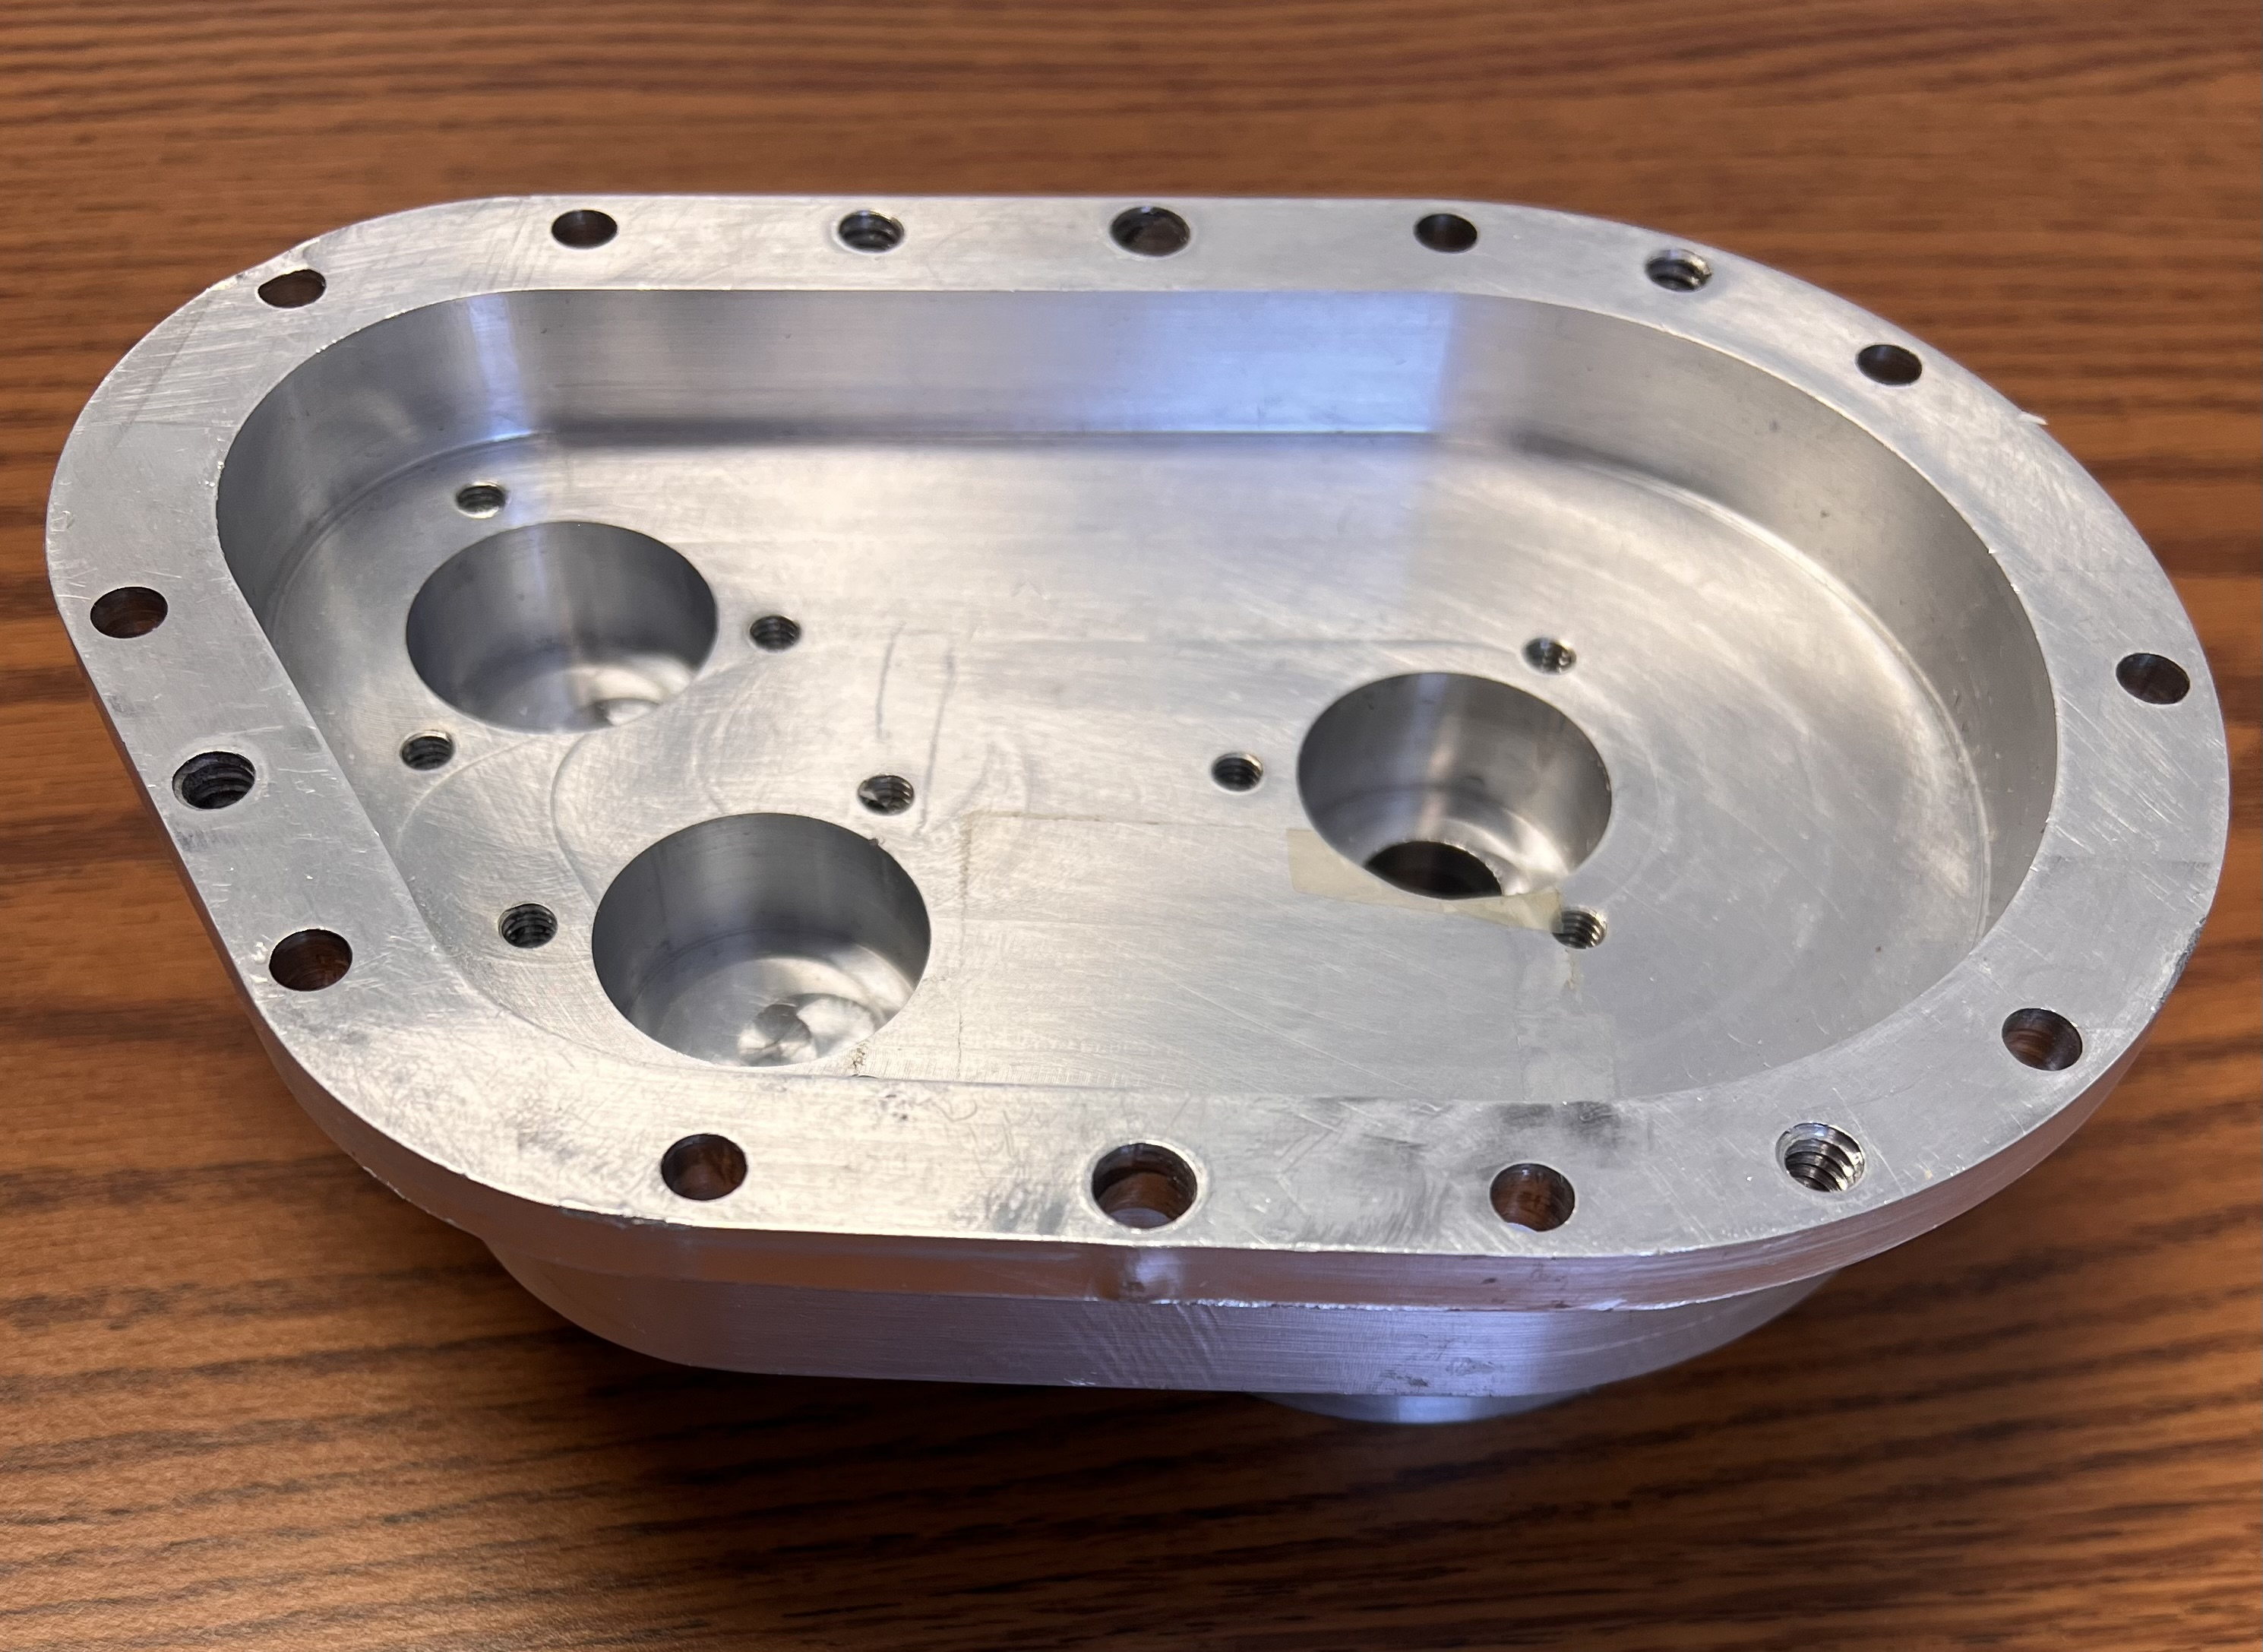
SIGN UP FOR ME 49700 if you are looking for a technical elective this summer (2026)
Course is offered online – asynchronous = Study and learn at your own pace!
ME 49700 – CAD/CAM Theory and Advanced Applications
Become an intelligent user of start-of-the-art CAD/CAM tools and technology and build highly desirable portable skills critical to your ability to compete for tomorrow’s ME jobs.
Course highlights:
Three aspects/components of the course:
1. Theory of CAD and CAM
2. NX CAD/CAM software
3. CAD/CAM application (CAD/CAM based development of a gear box casing)
Learn how to automate product development using integrated NX, and be ready for the digital transformation (Example shown: half of gearbox casing)

Slide 28


Slide 29


Slide 30


